Slide 1
Design of an IoT-enabled Scalable Closed Hydroponics System with Smart Parameter Control
Supervised by:
Dr. Lafifa Jamal Professor Department of Robotics and Mechatronics Engineering University of Dhaka
Proposed by: Mikdam-Al-Maad Ronoue Class Roll: FH-092-003 MD. Sameer Iqbal Chowdhury Class Roll: SH-092-002

Slide 2
Methodology

Slide 3
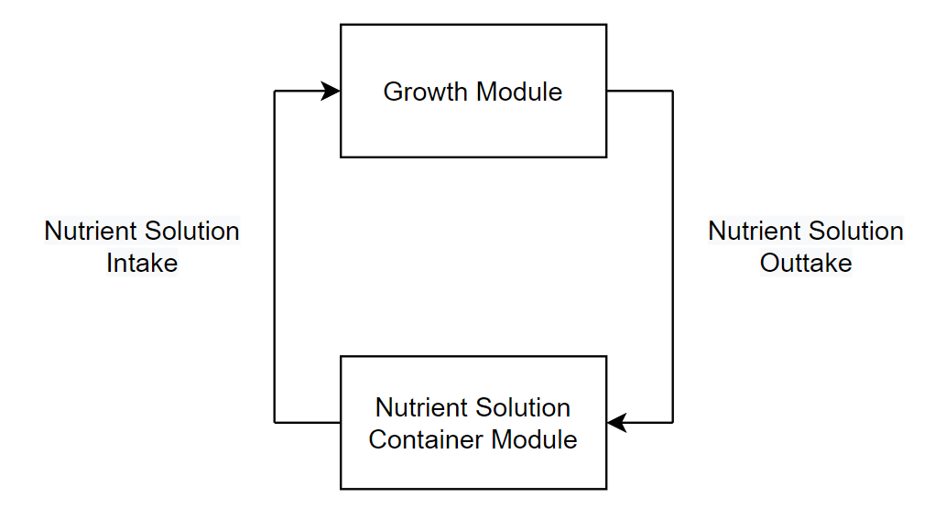
Overview
Fig. 1: Simplified outline of the system illustrating the flow of nutrient solution

Slide 4

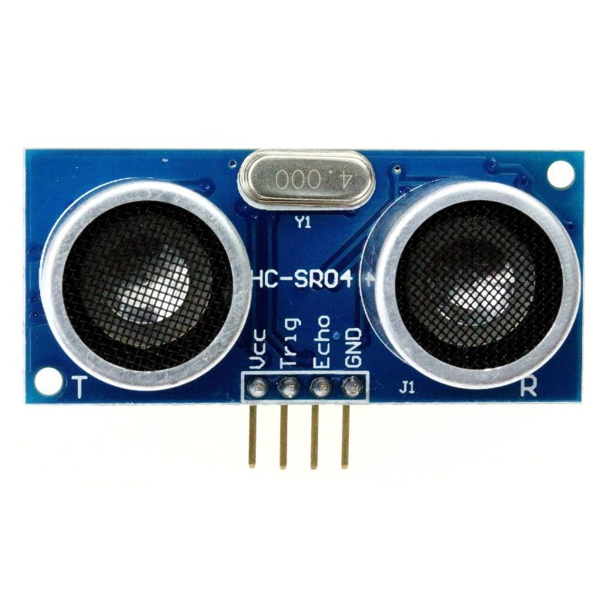
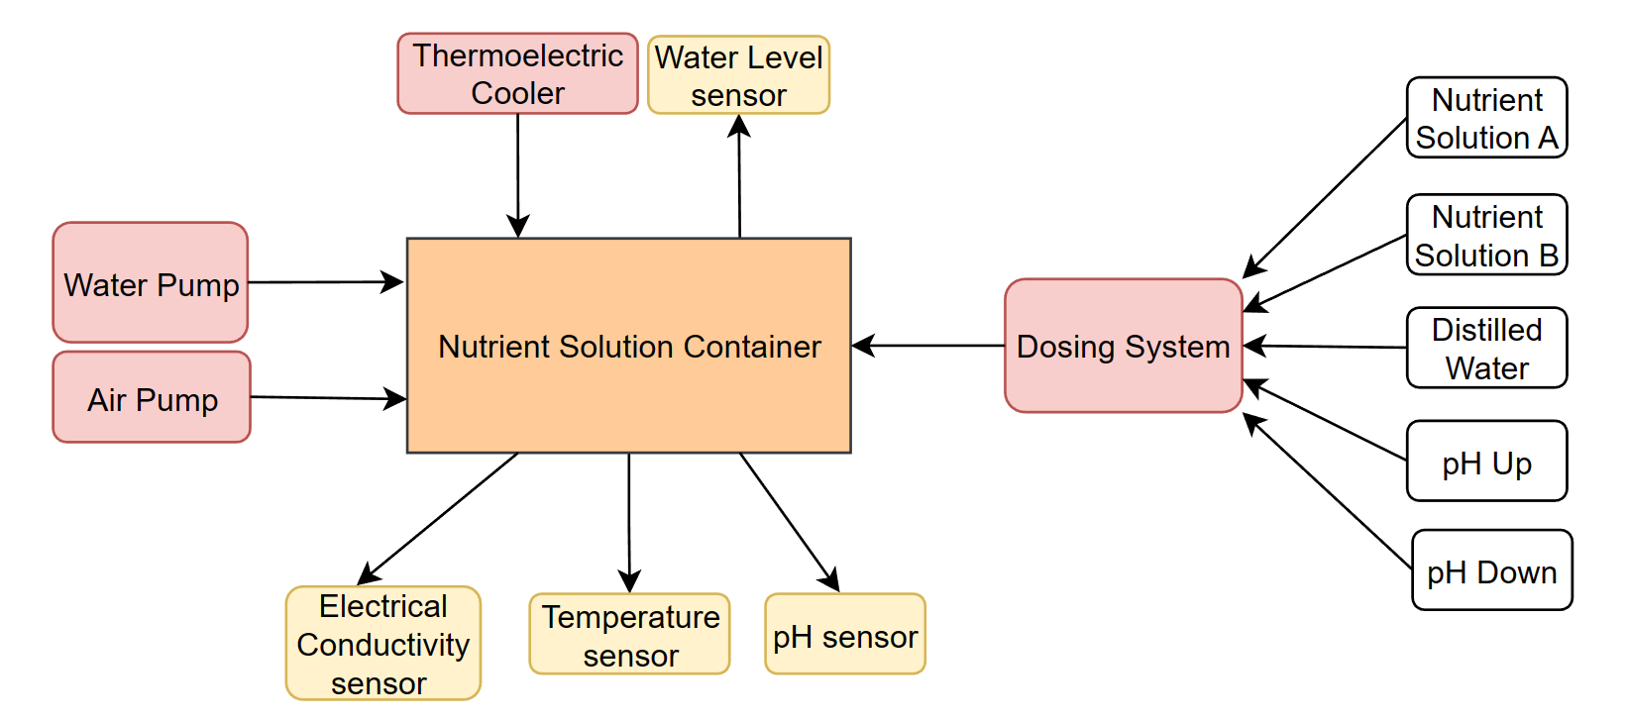
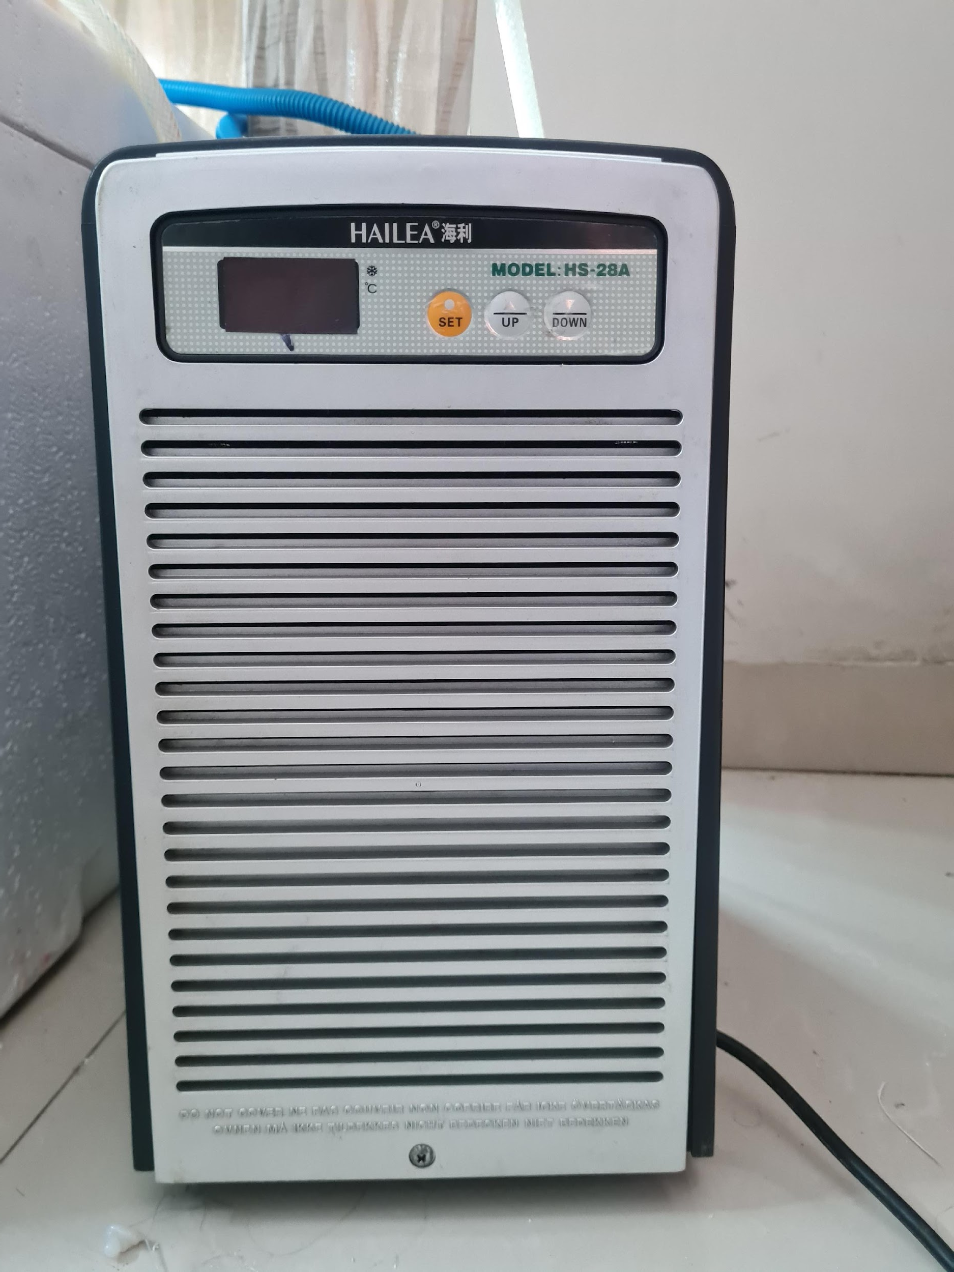
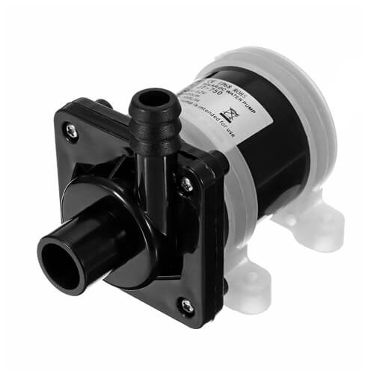
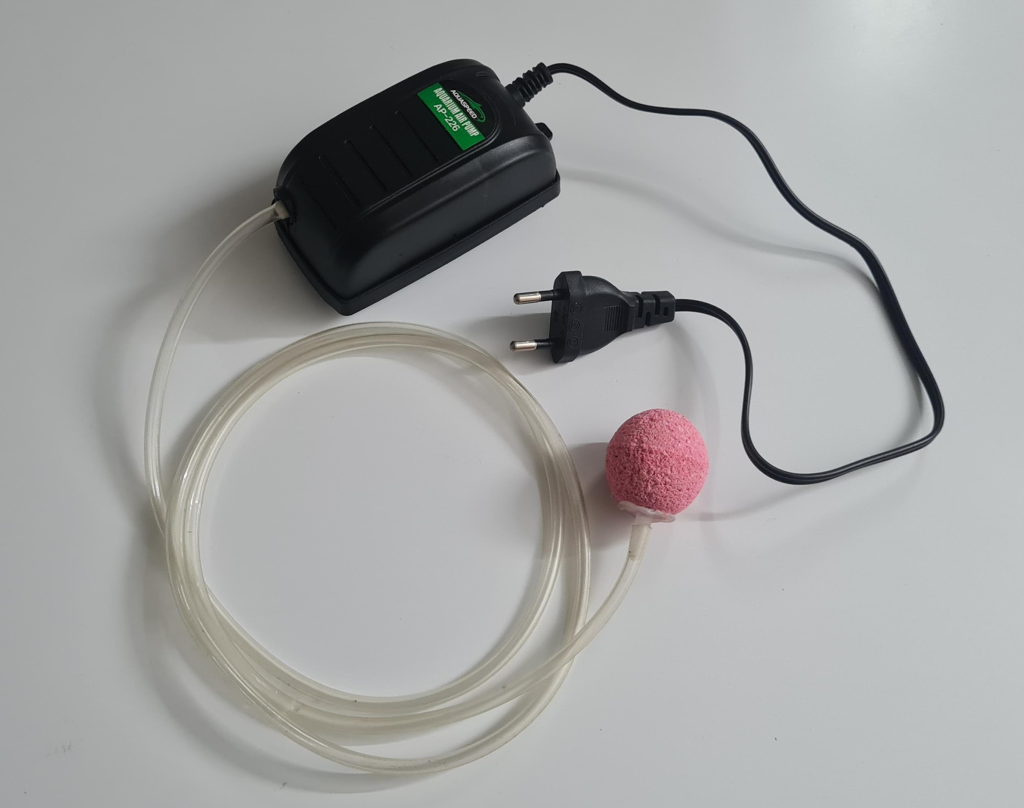
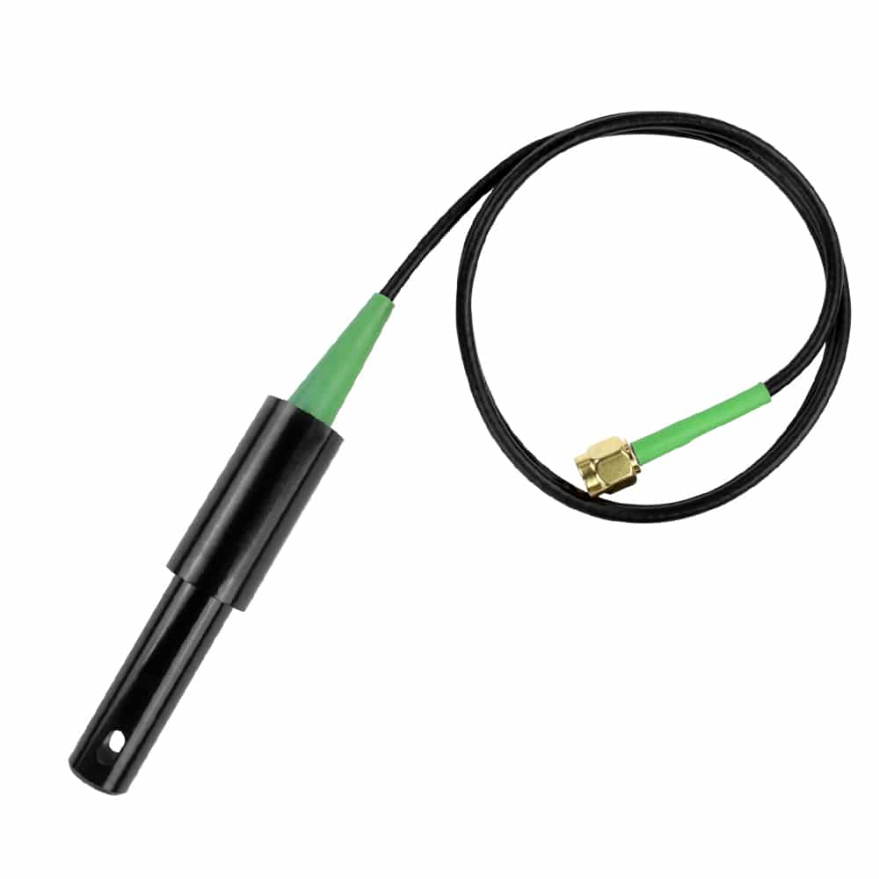
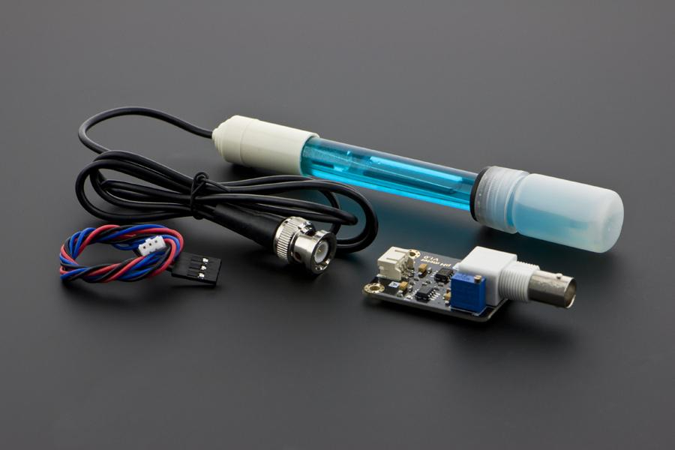
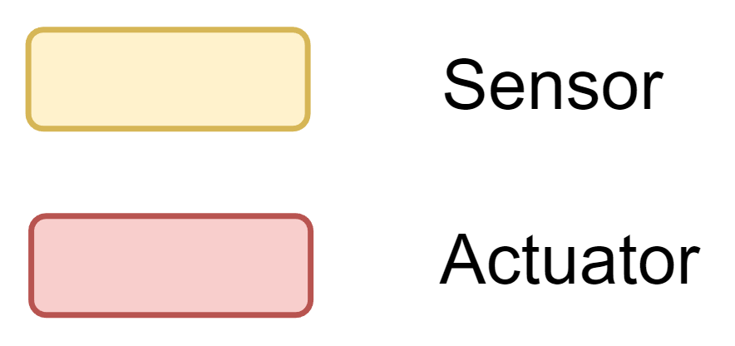
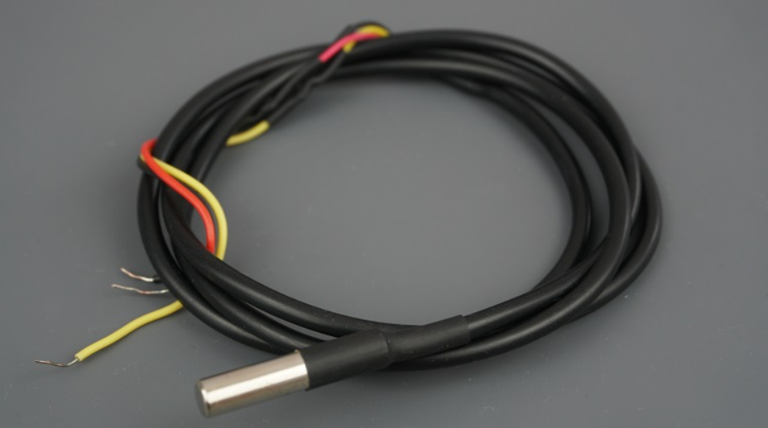
Nutrient Solution Container Module
Fig. 2: Block diagram for communication between microcontrollers and the central server

Slide 5
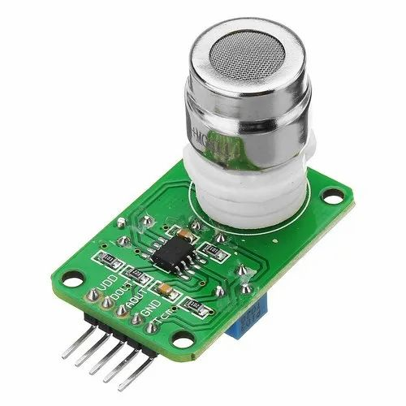
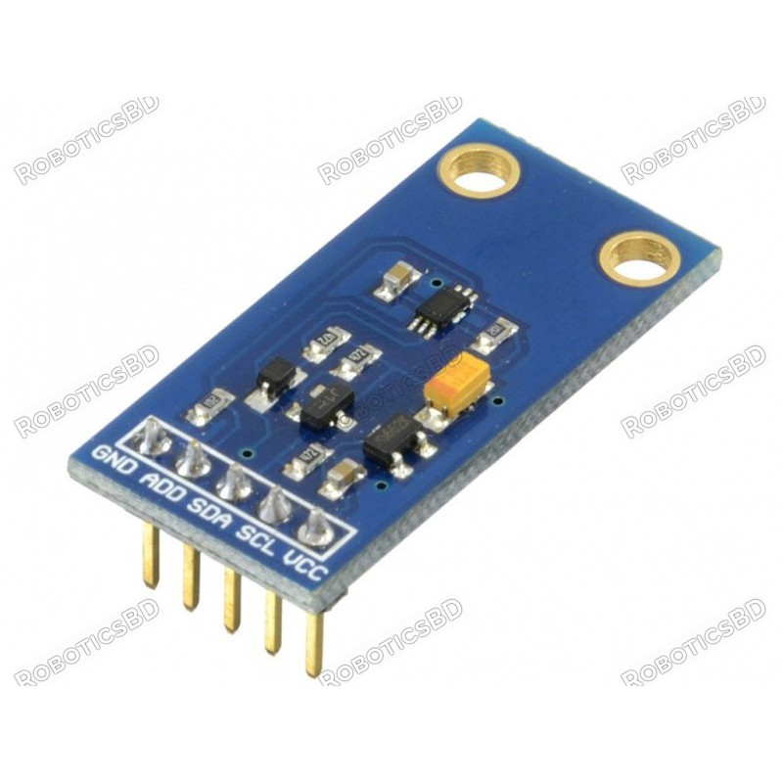
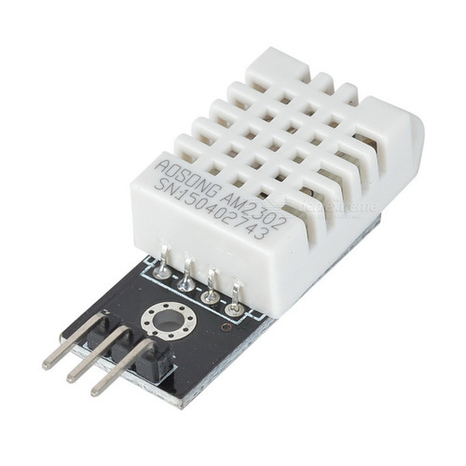
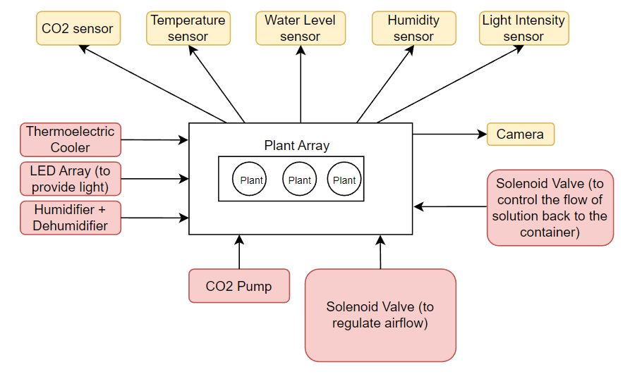
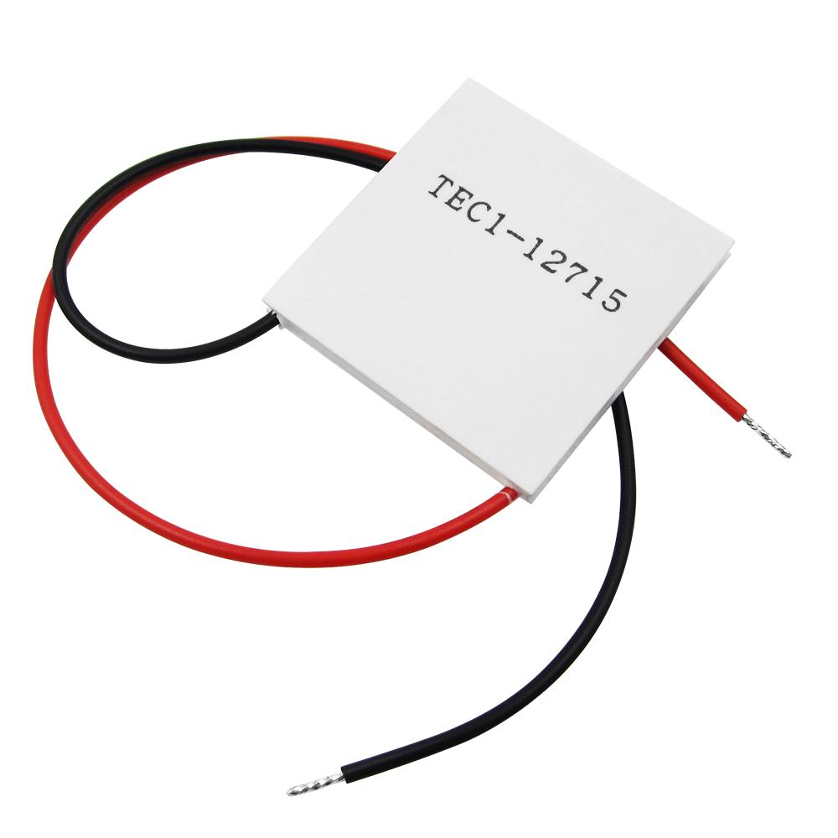
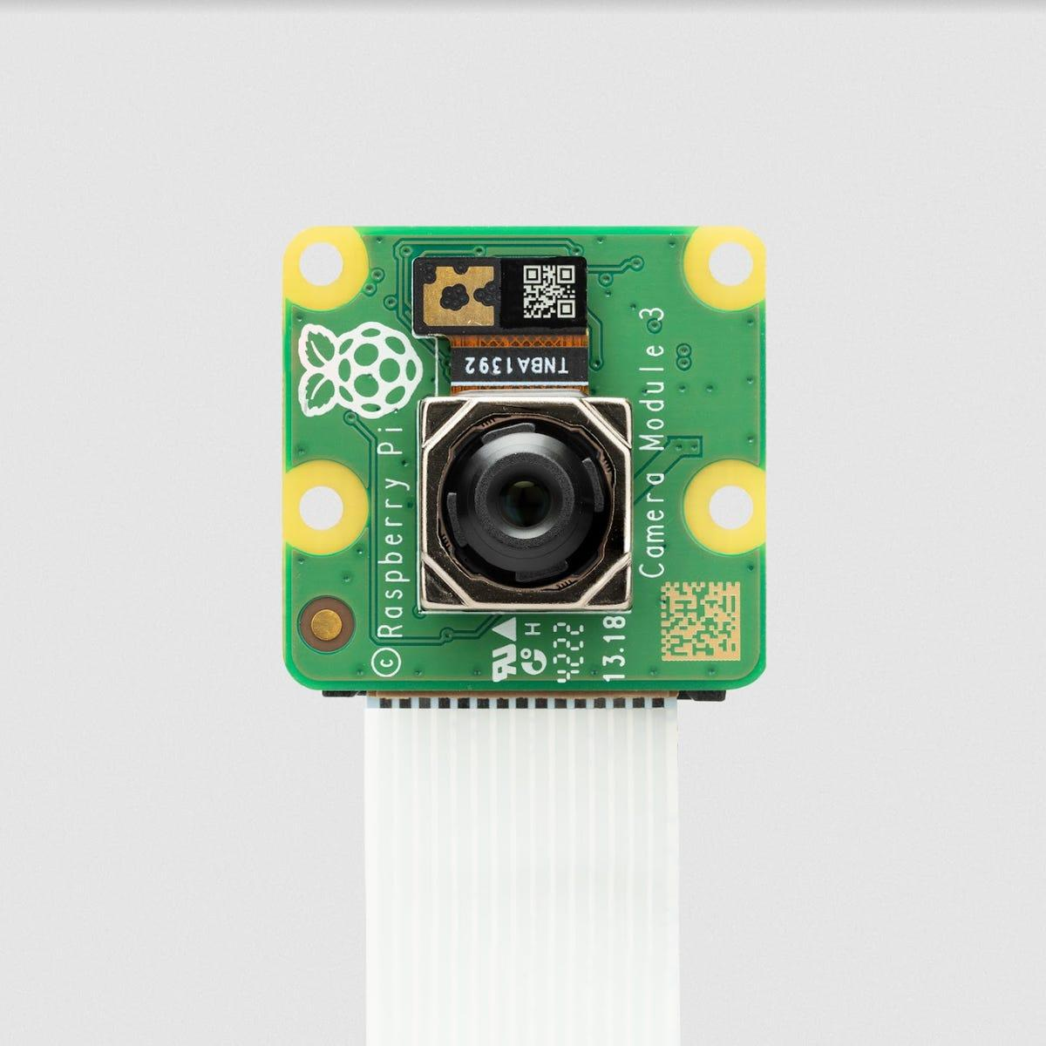
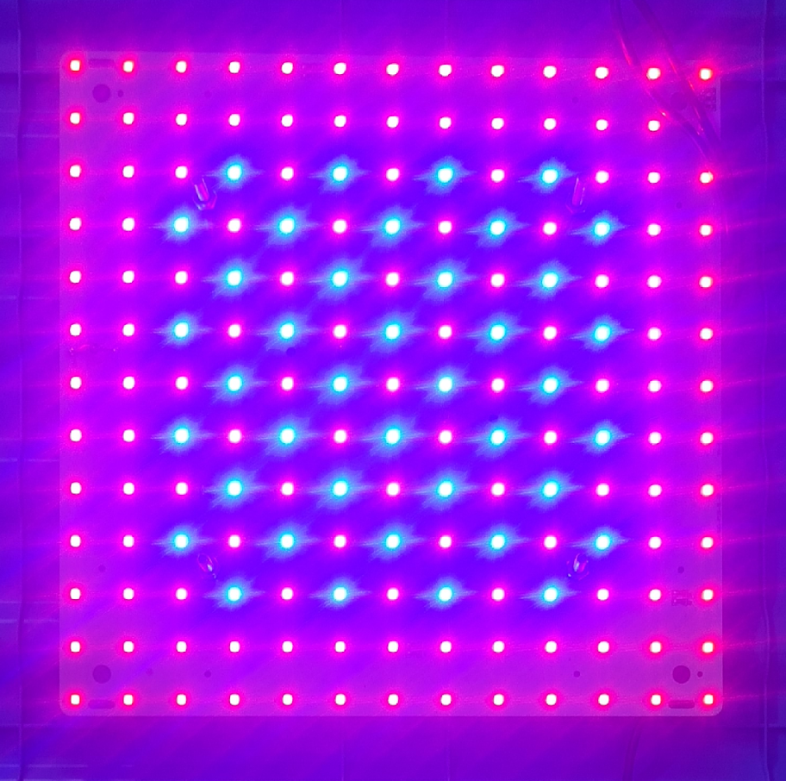
Growth Module
Fig. 3: Block diagram for the Growth Module

Slide 6
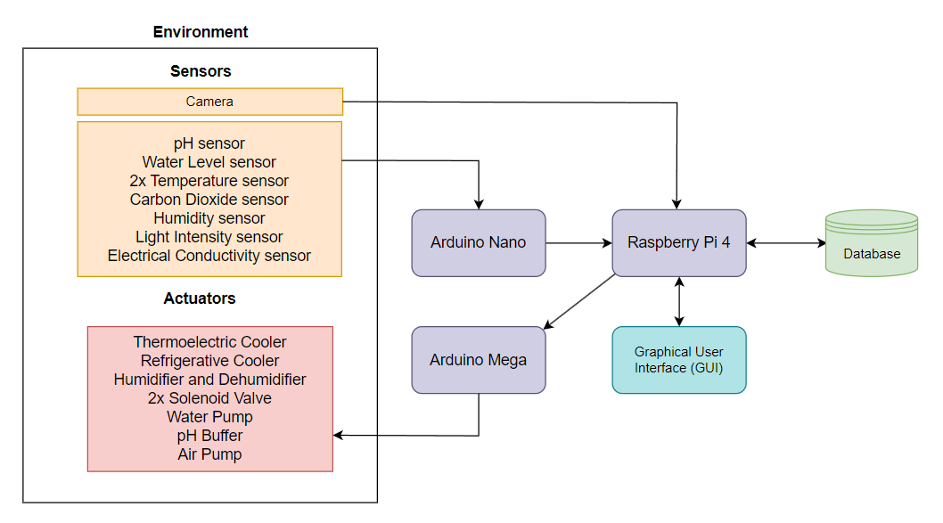
Control System
Fig. 4: Block Diagram illustrating the IoT framework running on the system

Slide 7
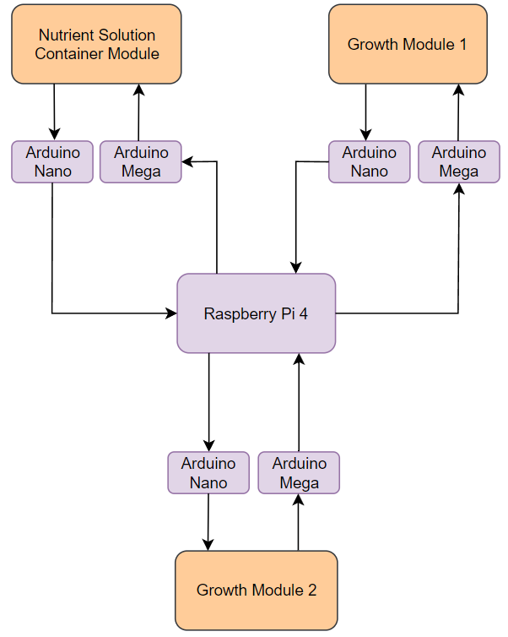
Overview for scaled system
Fig. 5: Block diagram for communication between microcontrollers and the central server

Slide 8
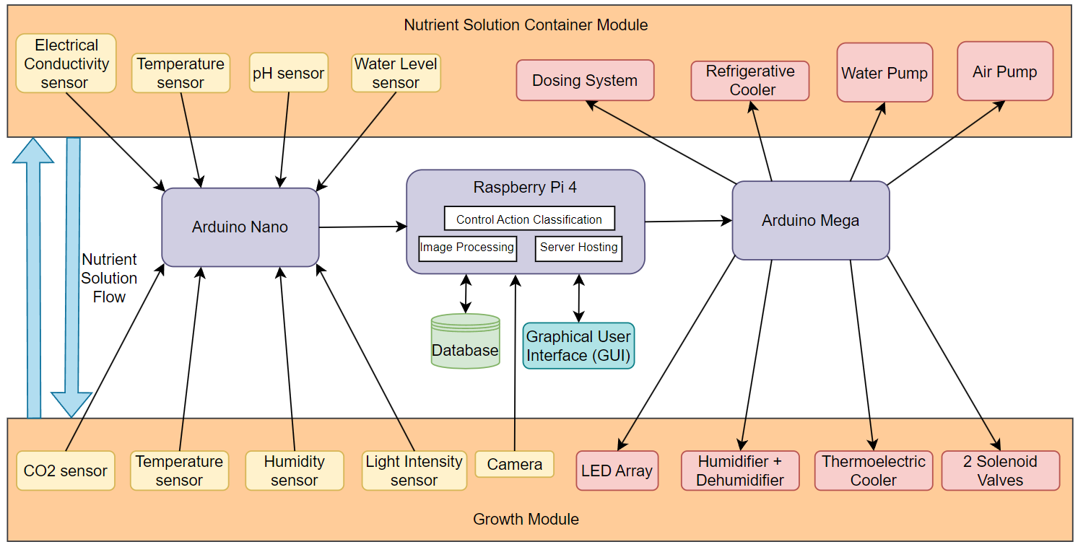
Full System Flow Diagram
Fig. 6: Complete flow diagram of the entire system illustrating the interconnections between all the components

Slide 9
Work Done Thus Far

Slide 10
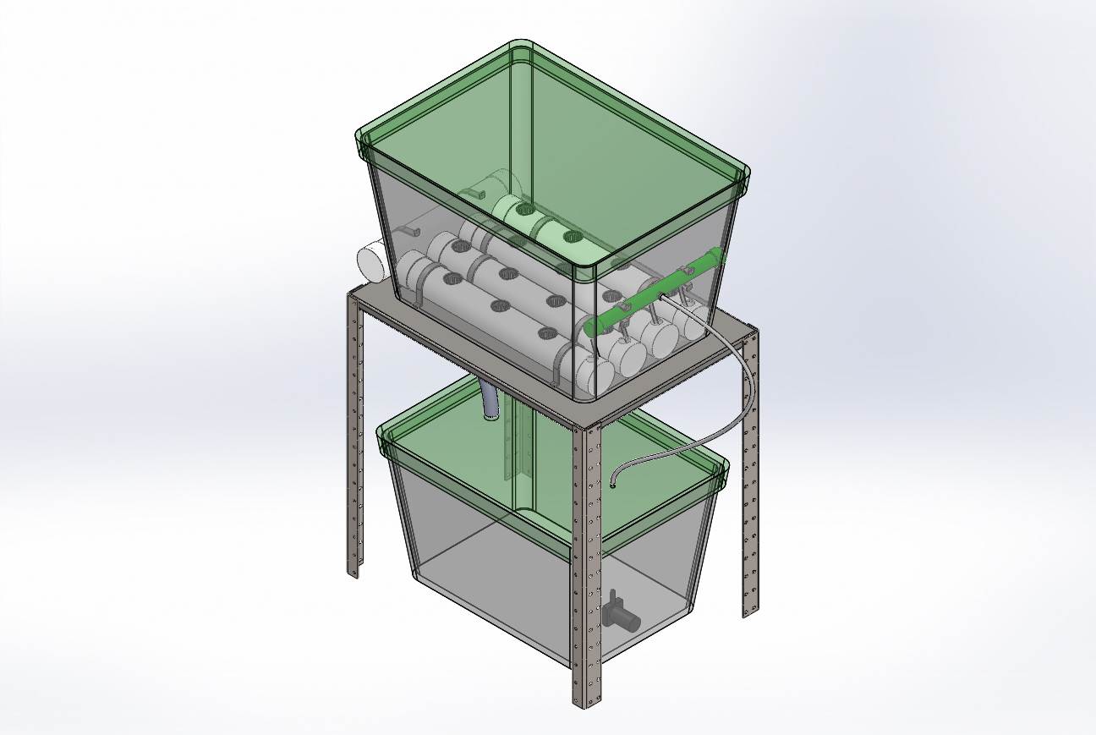
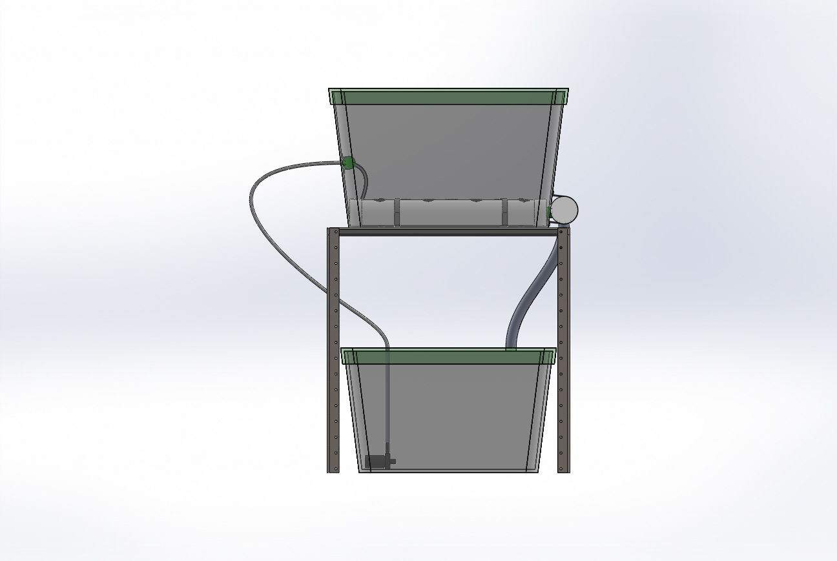
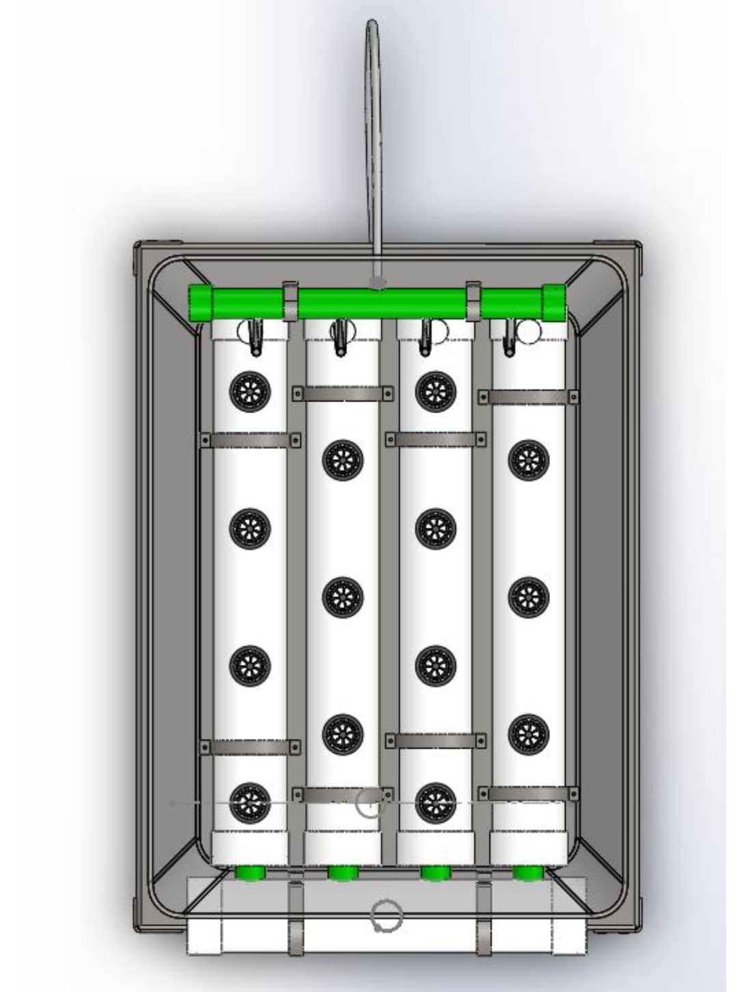
3D CAD Model
Growth Module
Distribution uPVC Pipe
Distribution Hose Pipe
Bracket
Drainage uPVC Pipe
Nutrient Solution
Container Module
Plant Housing
Pipe
Submersible Water Pump
Drainage
Hose Pipe
Net pot
Fig. 8: Multiple views of the model.

Slide 11
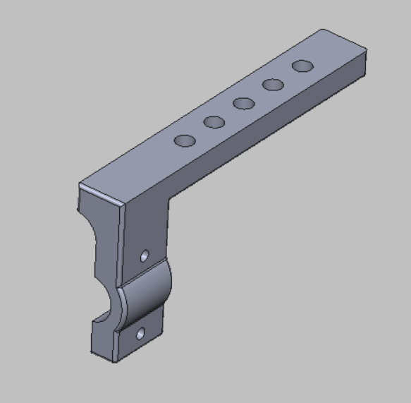
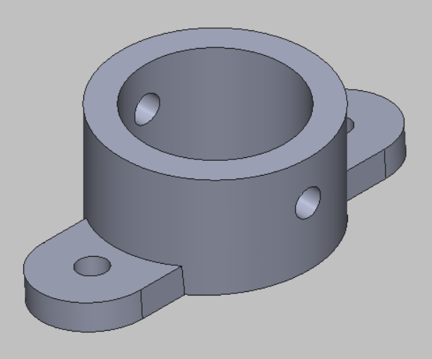
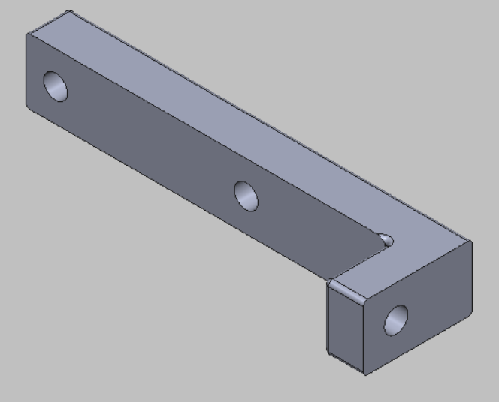
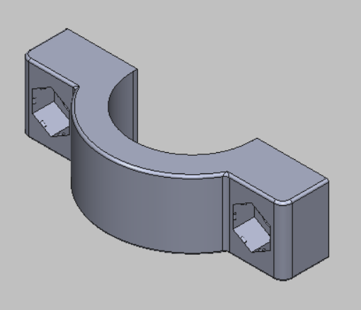
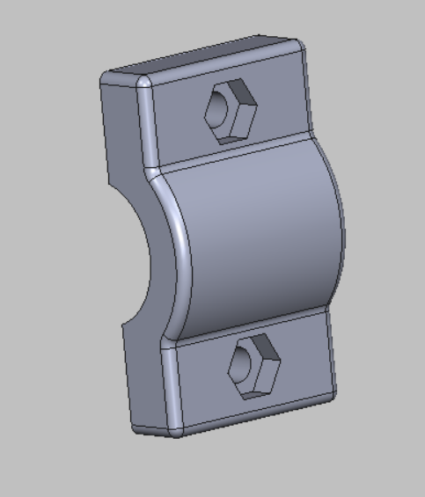
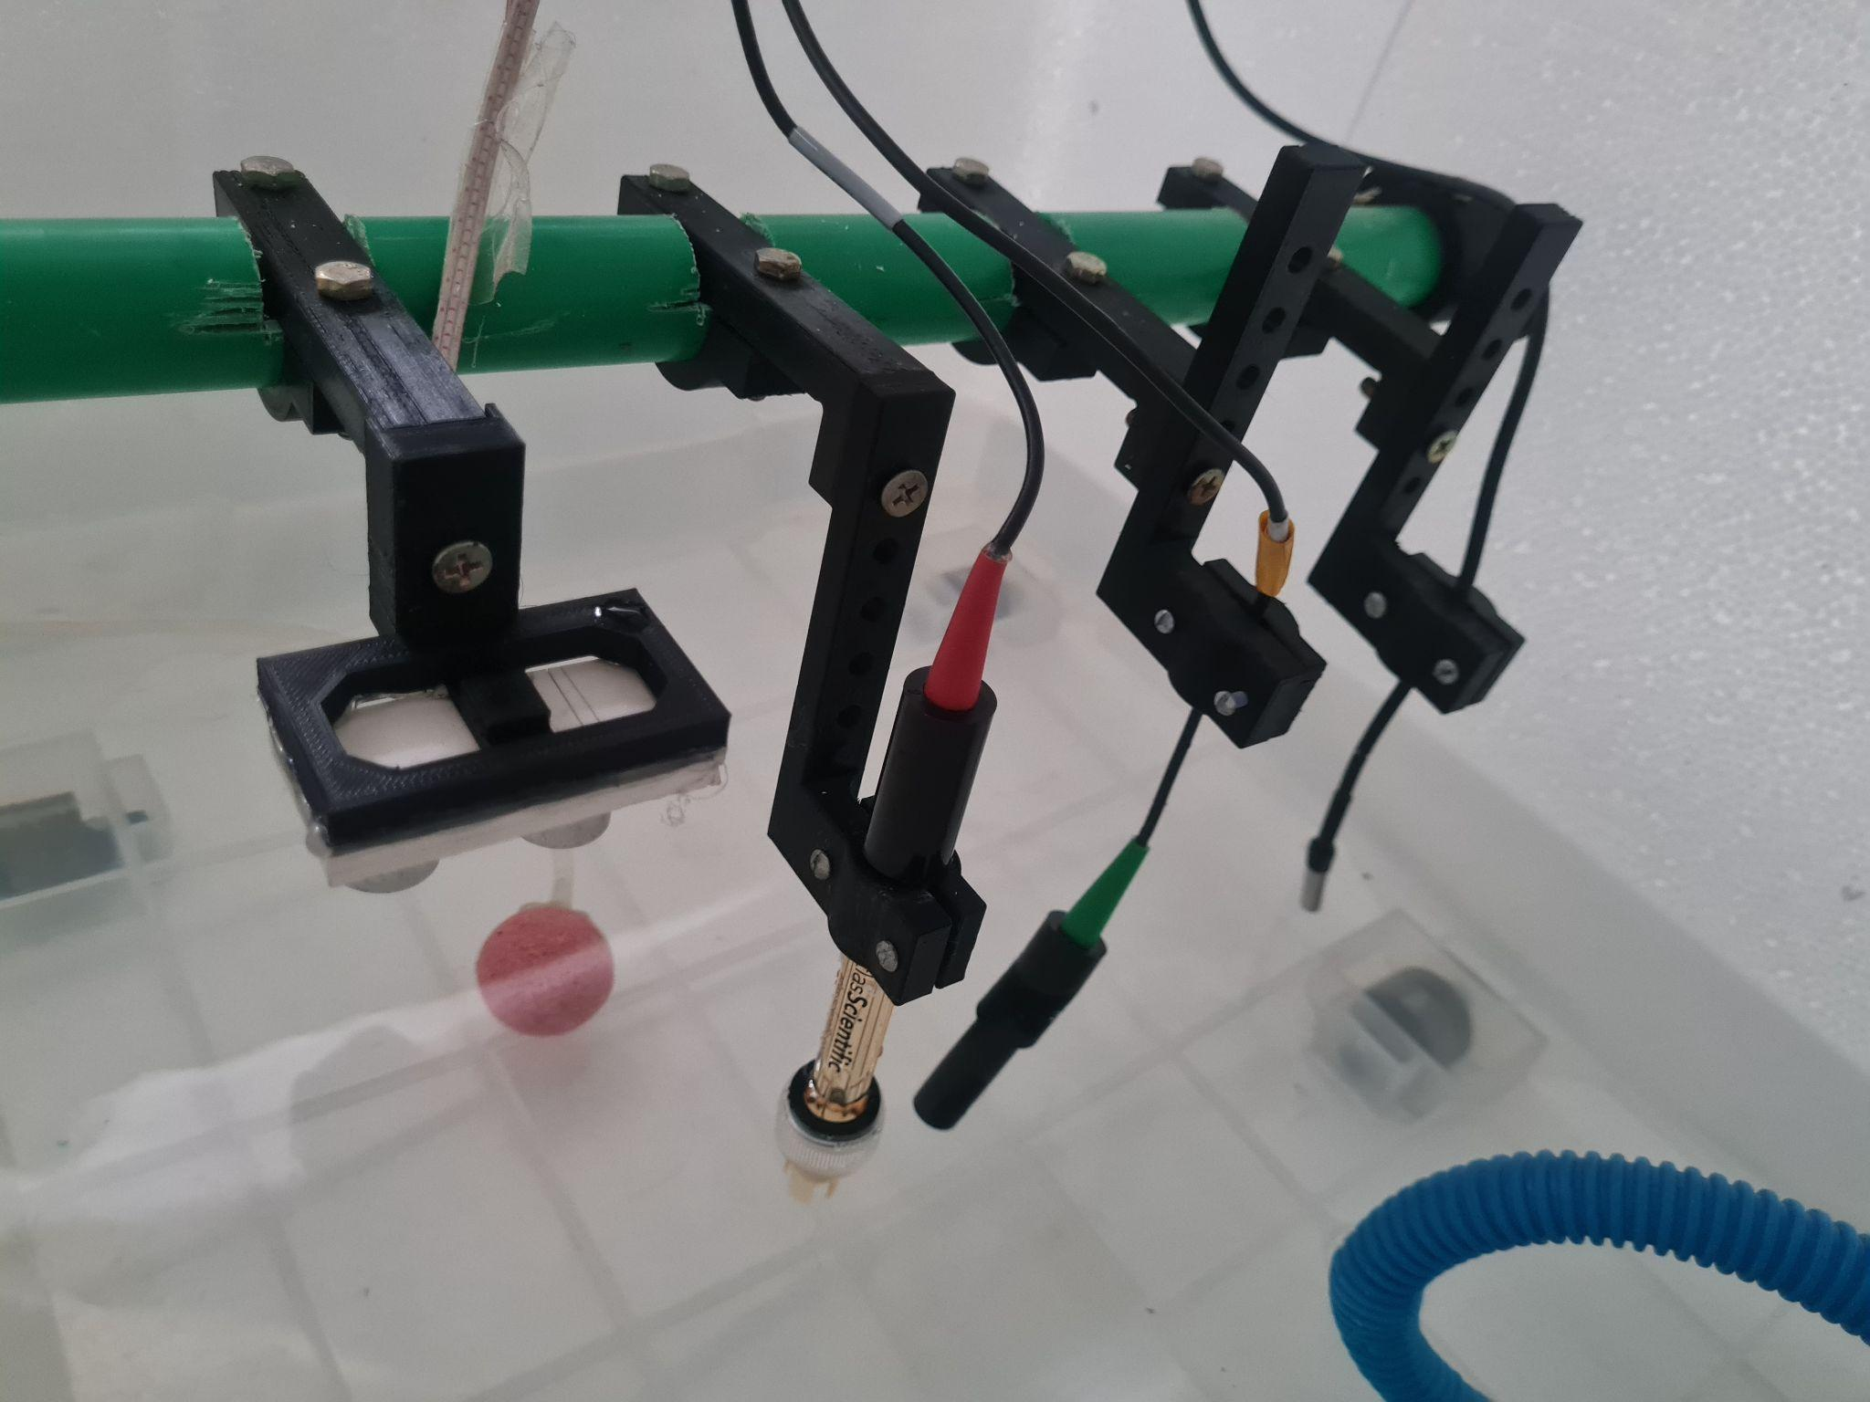
3D CAD Model
Fig. 10: Sensor holder 3D models.

Slide 12
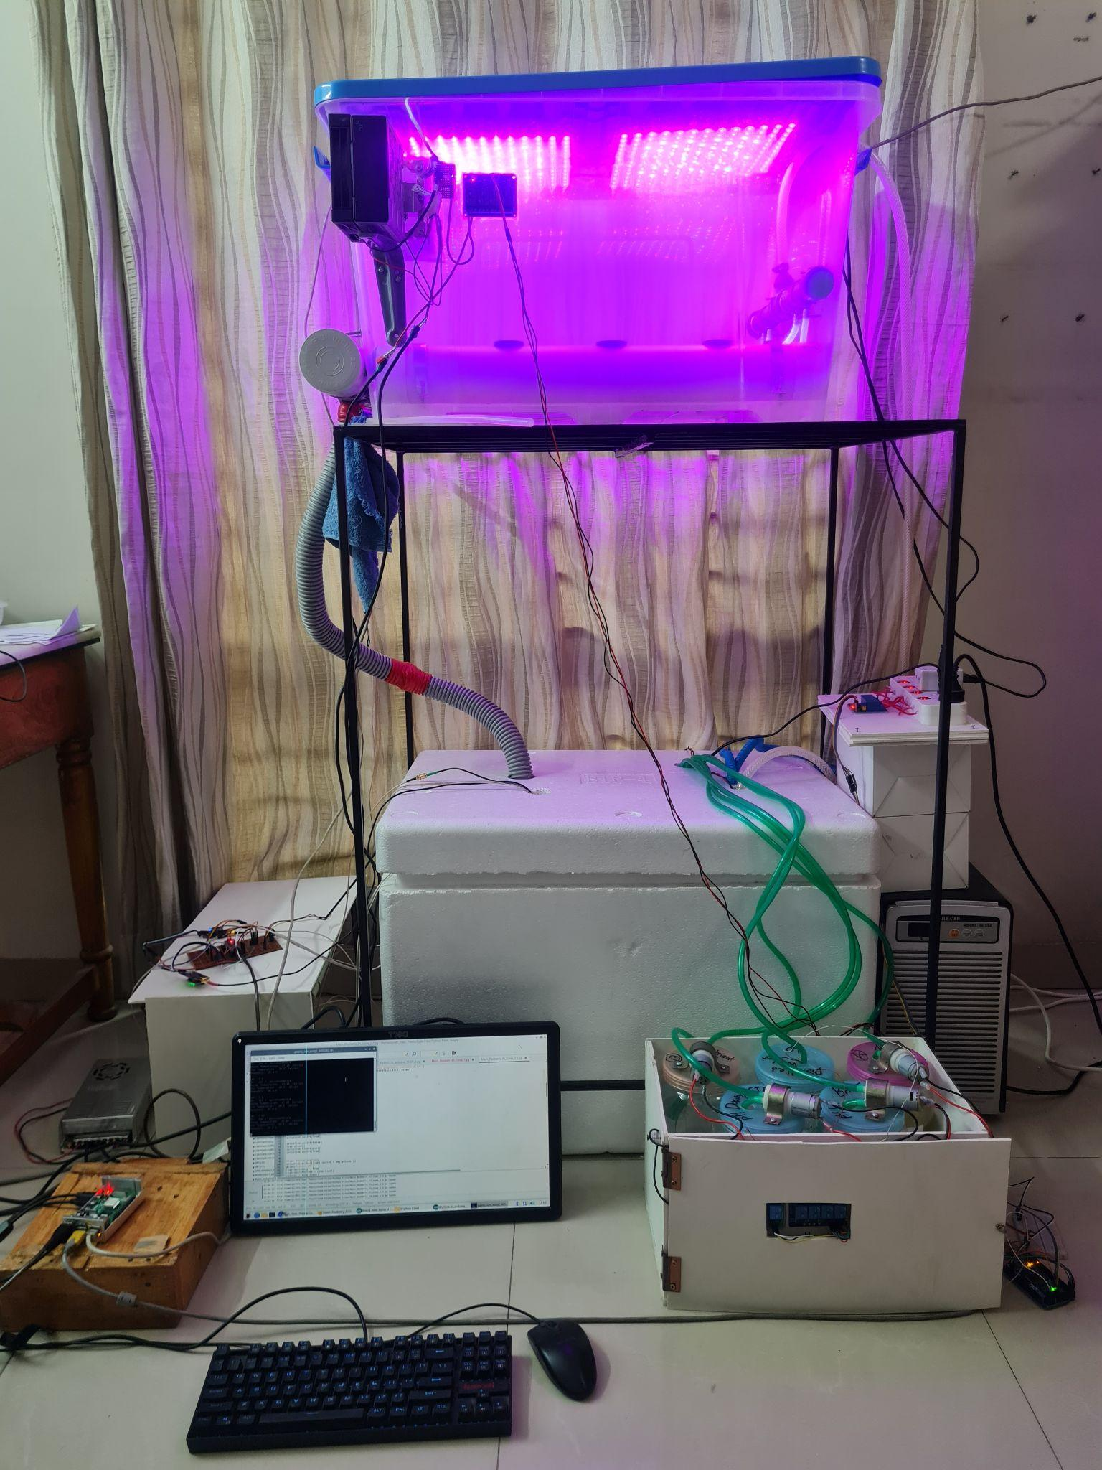
Physical Implementation
Fig. 13: Front view of the system with Grow Lights turned on

Slide 13
Physical Implementation
Sensor Holders
Temperature
Probe
Ultrasonic
Sensor
pH
Probe
EC Probe
Fig. 15: Ultrasonic sensor, pH probe, EC probe and temperature probe held above the nutrient solution by the sensor holders

Slide 14
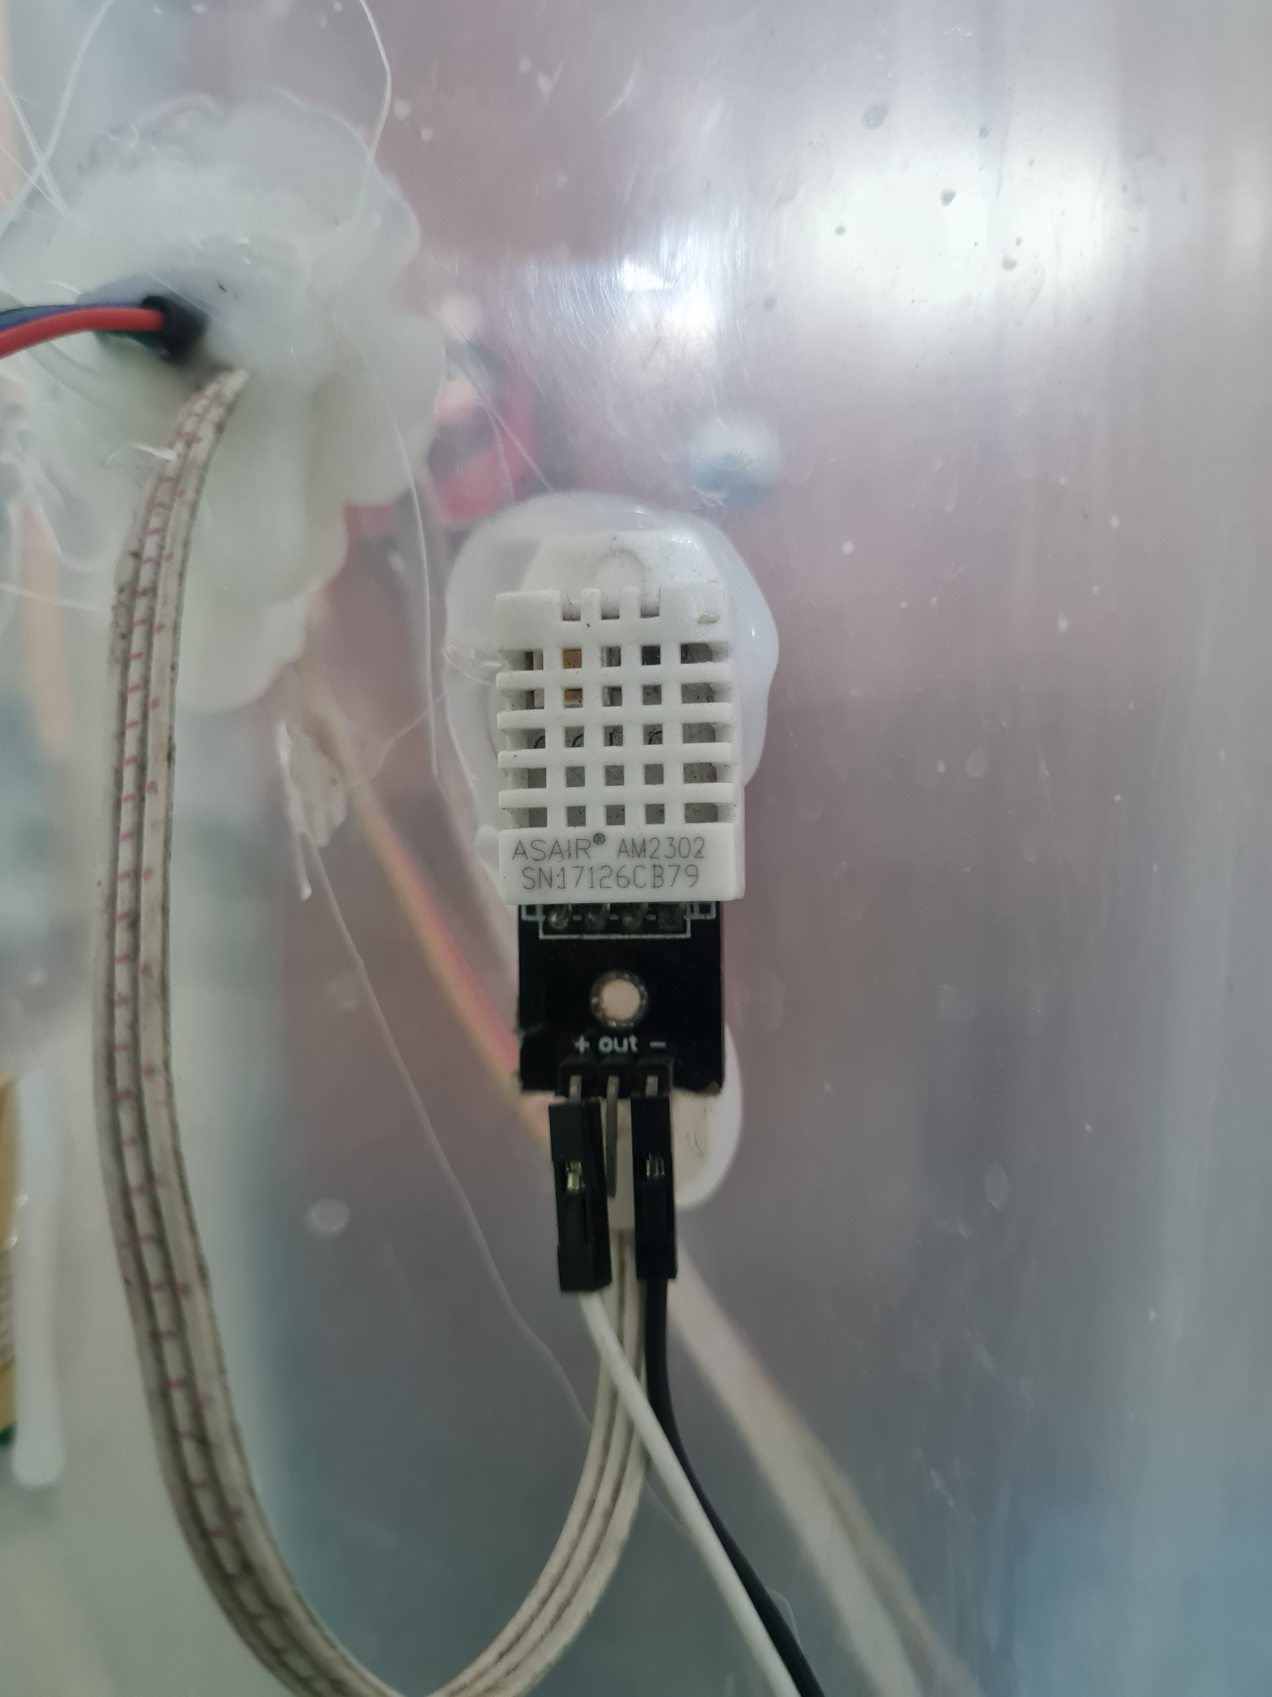
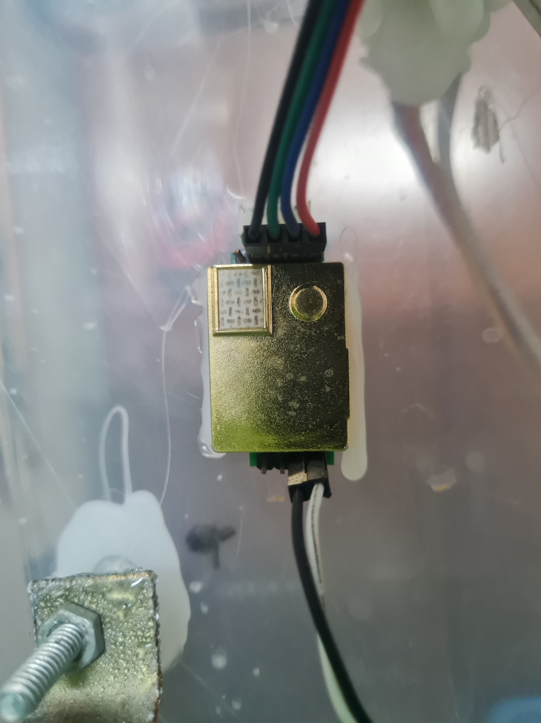
Physical Implementation
CO2 Sensor
DHT22 Temperature and Humidity Sensor
Fig. 16: Sensors in the Growth Module

Slide 15
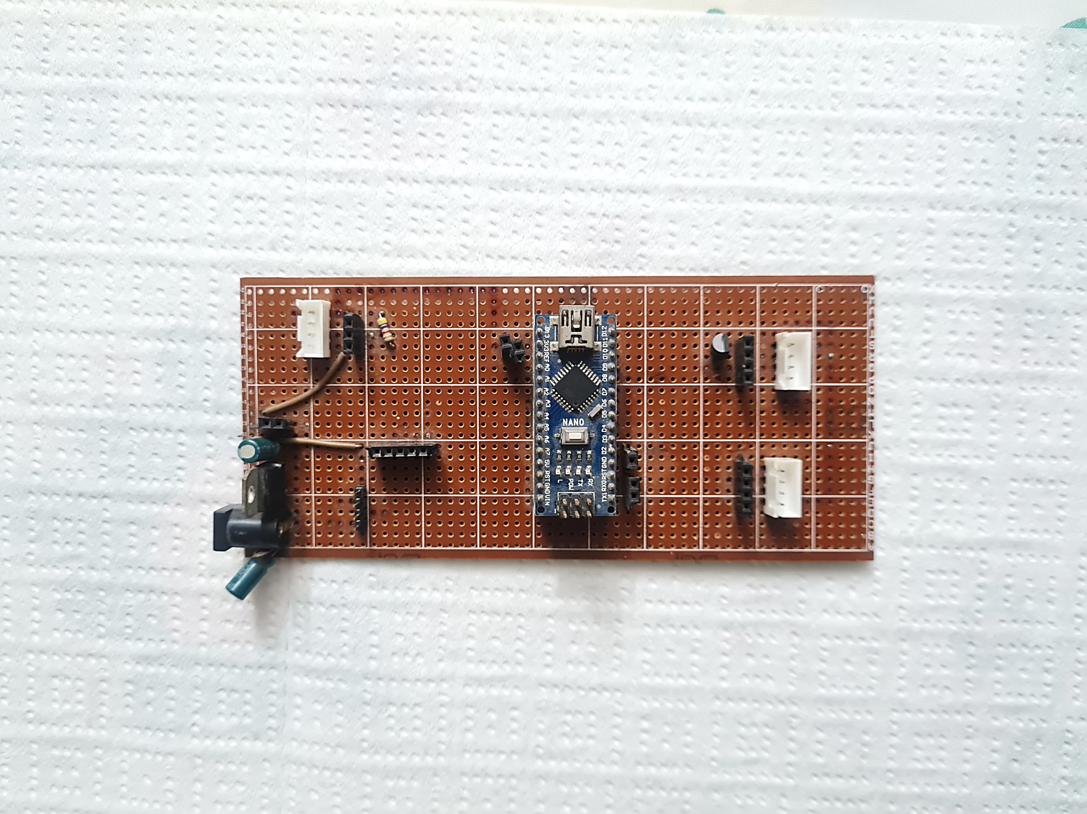
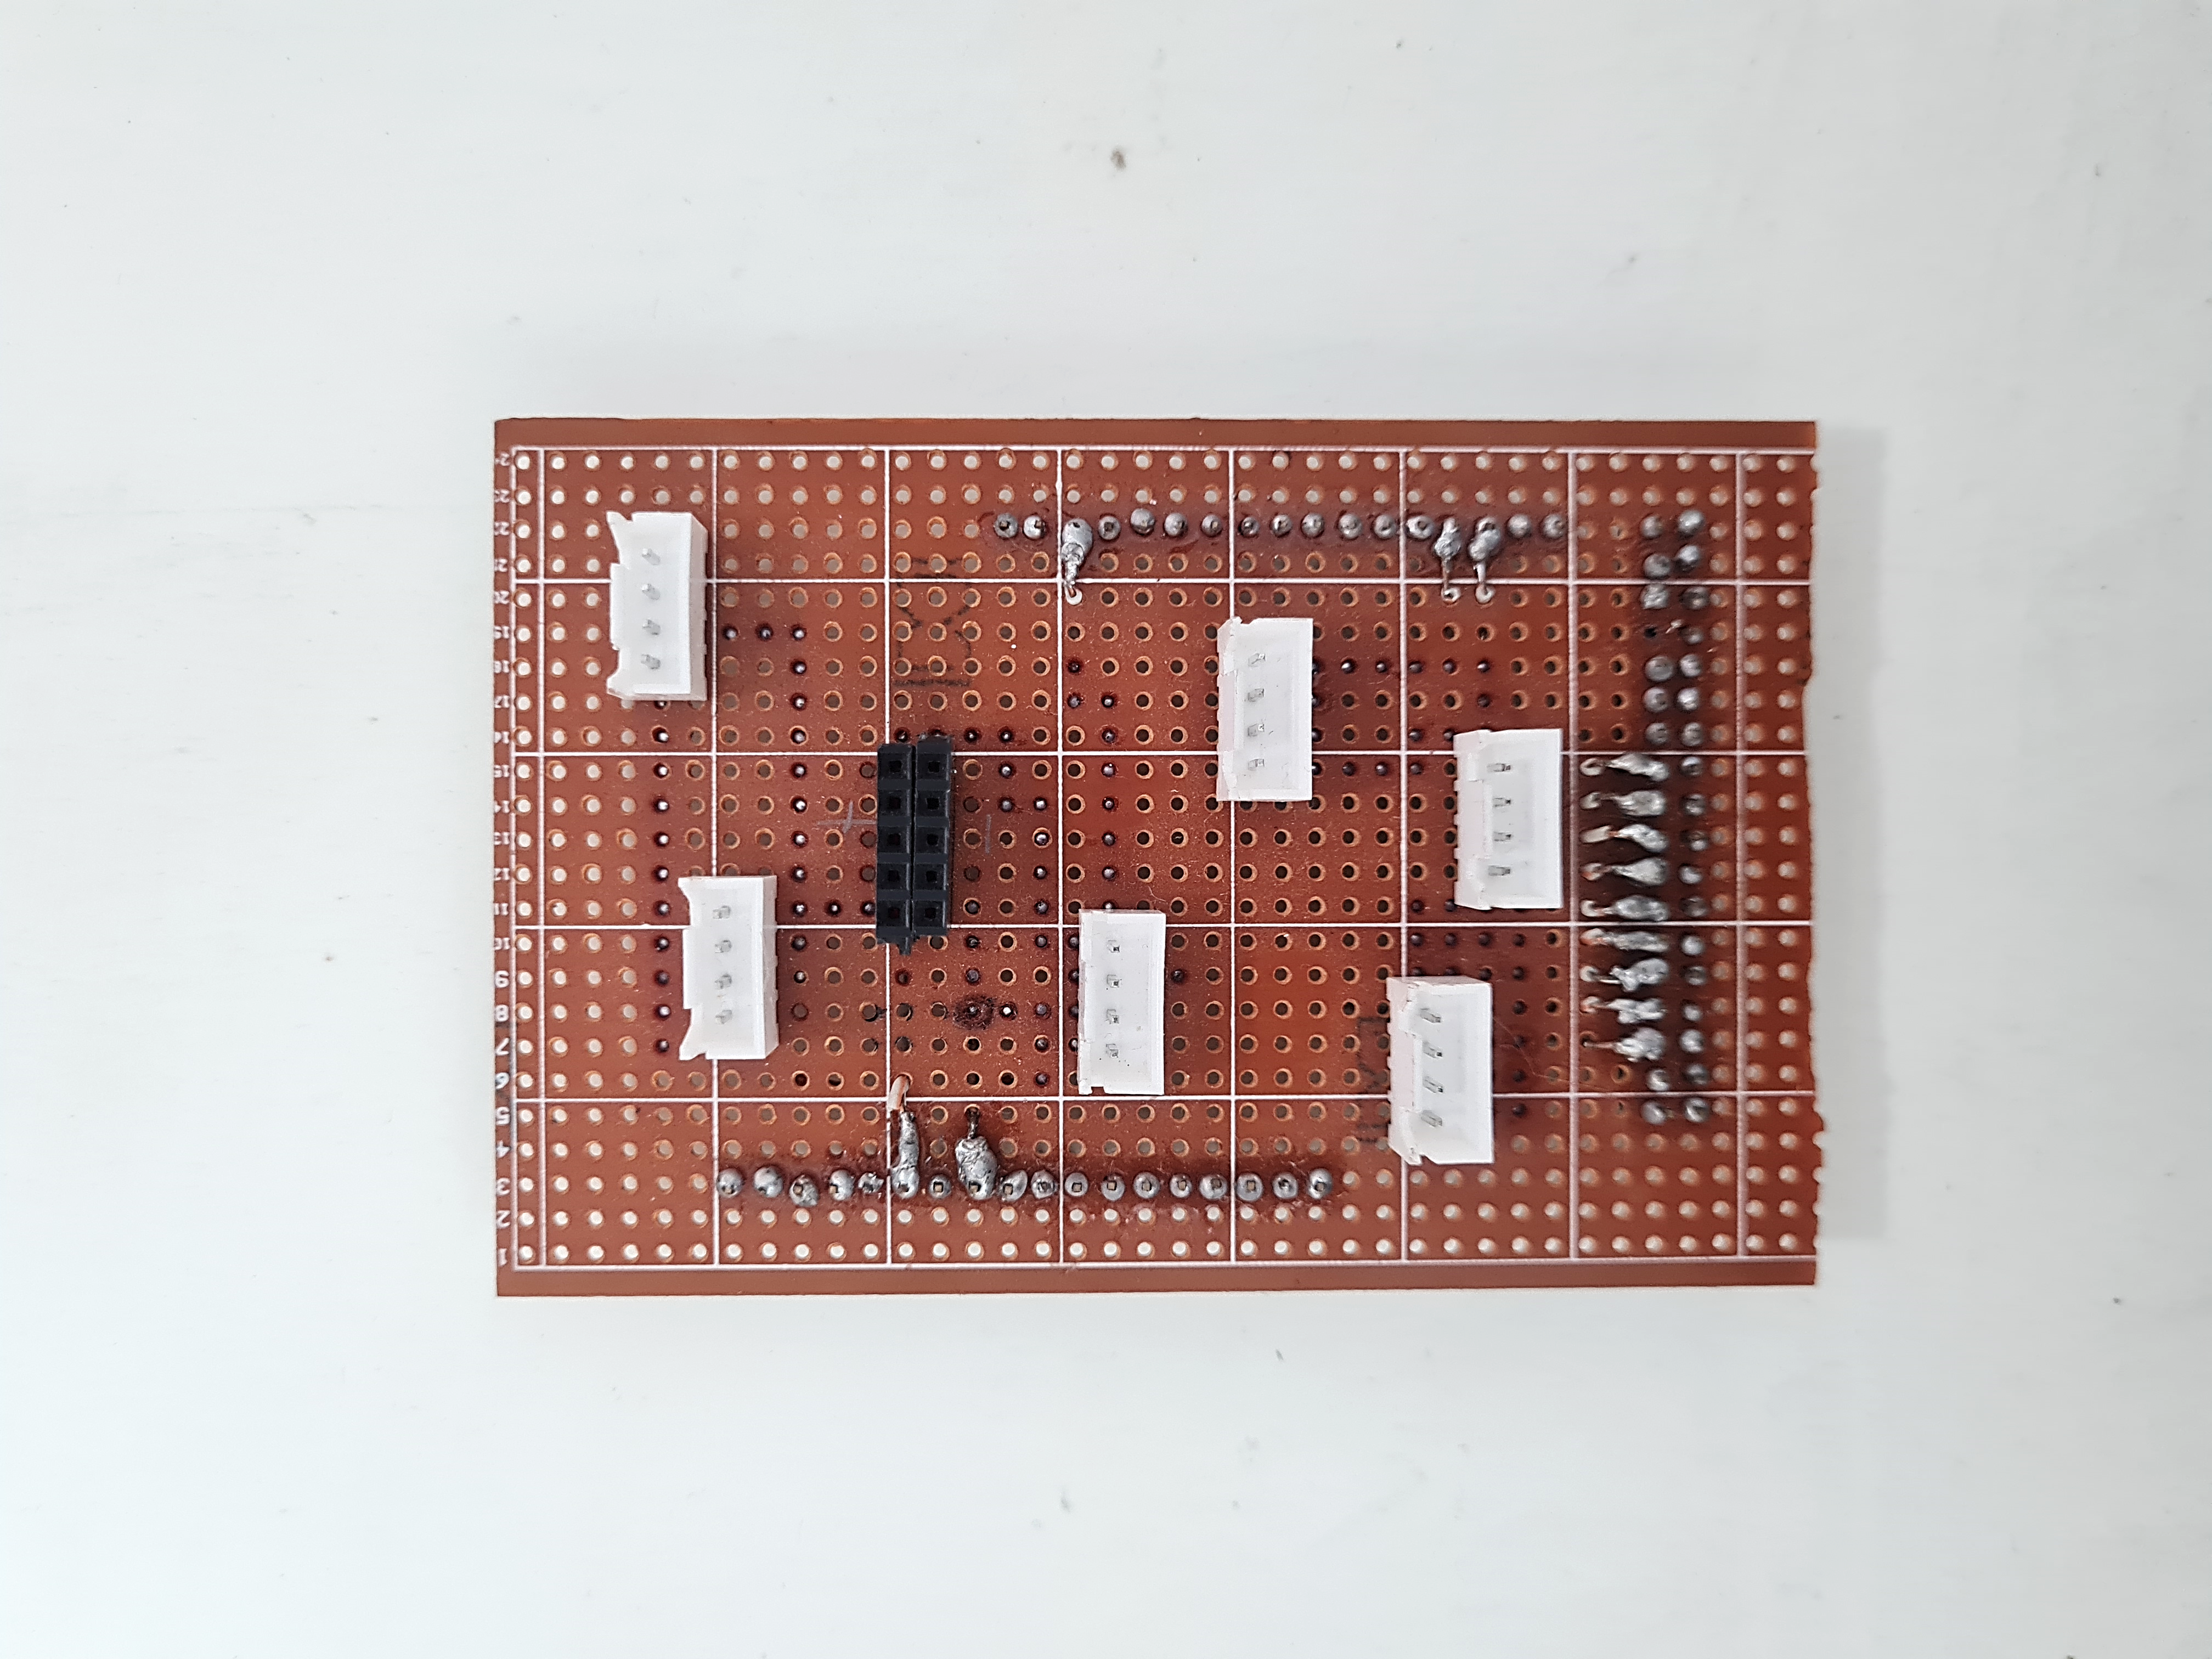
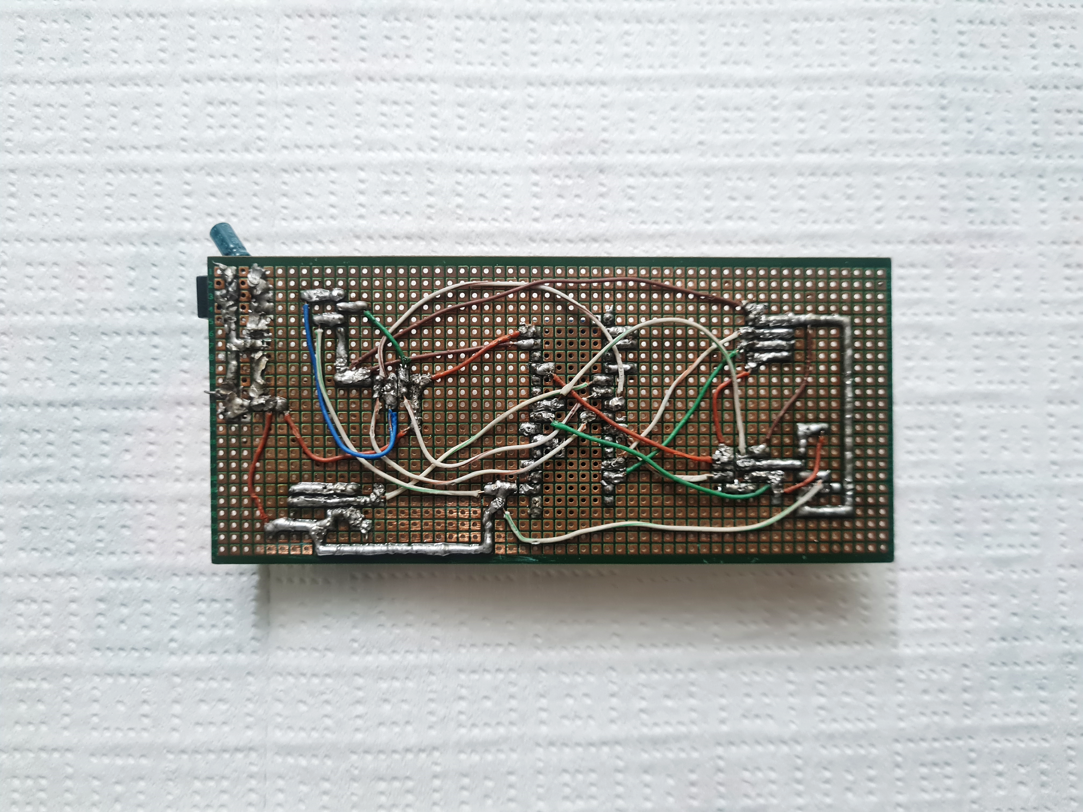
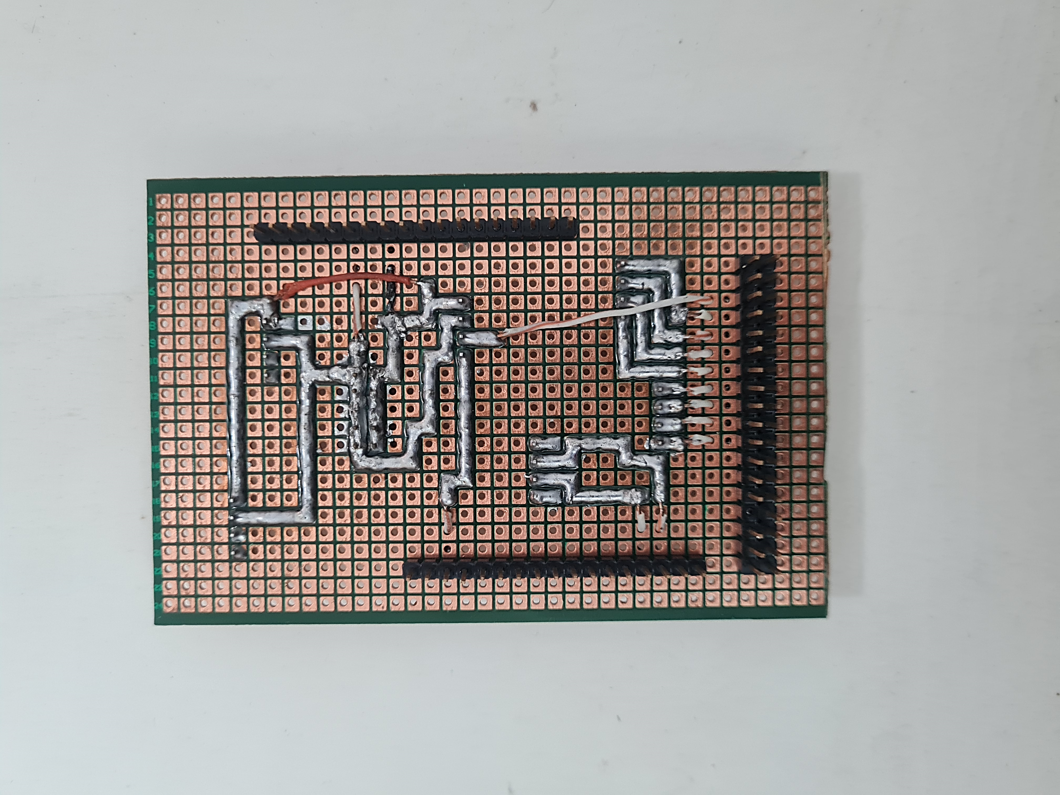
Sensor Reading
Fig. 17.1: Arduino Nano Sensor Board
Fig. 17.1: Arduino Mega Sheild Board

Slide 16
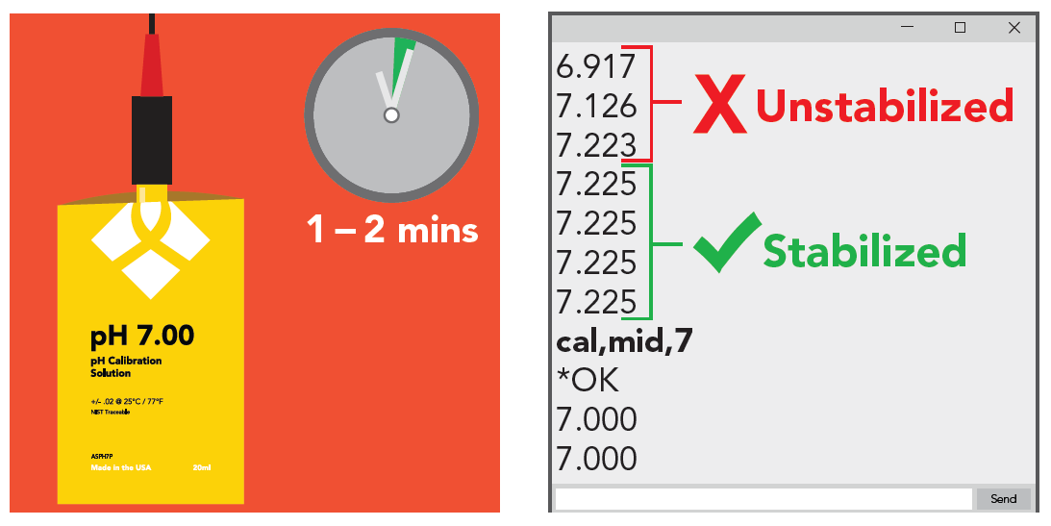
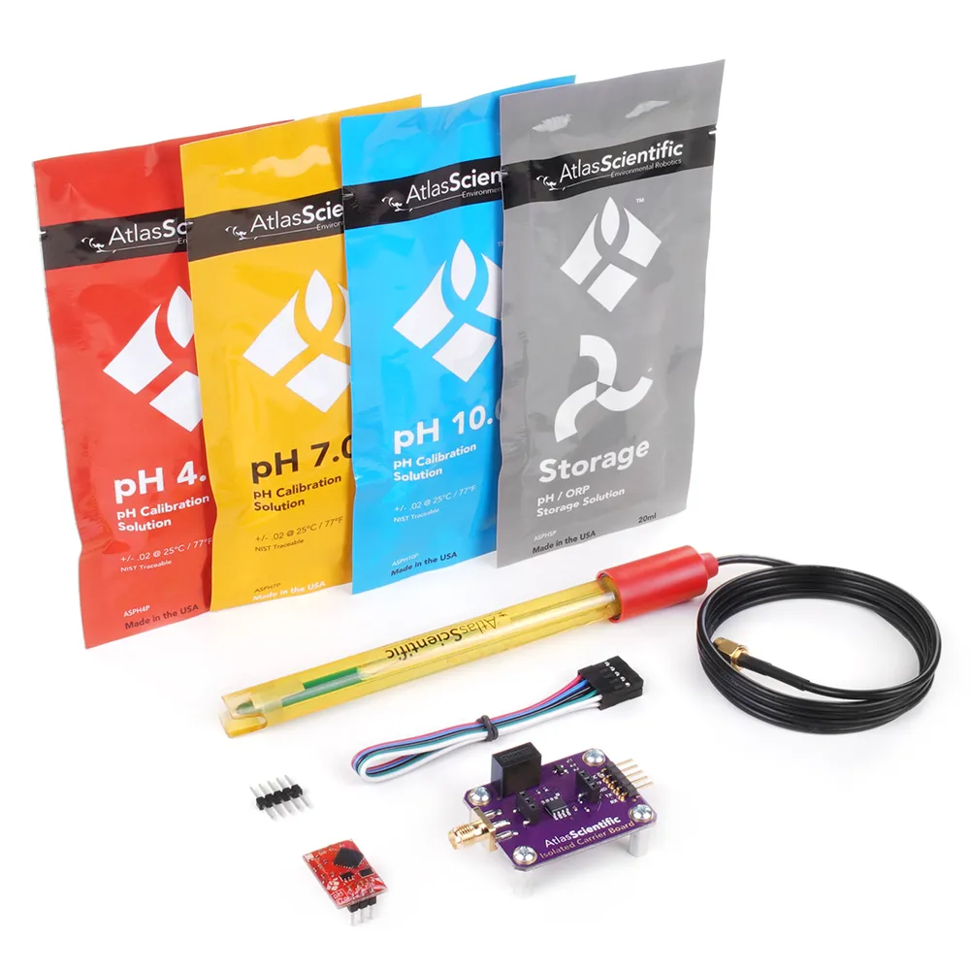
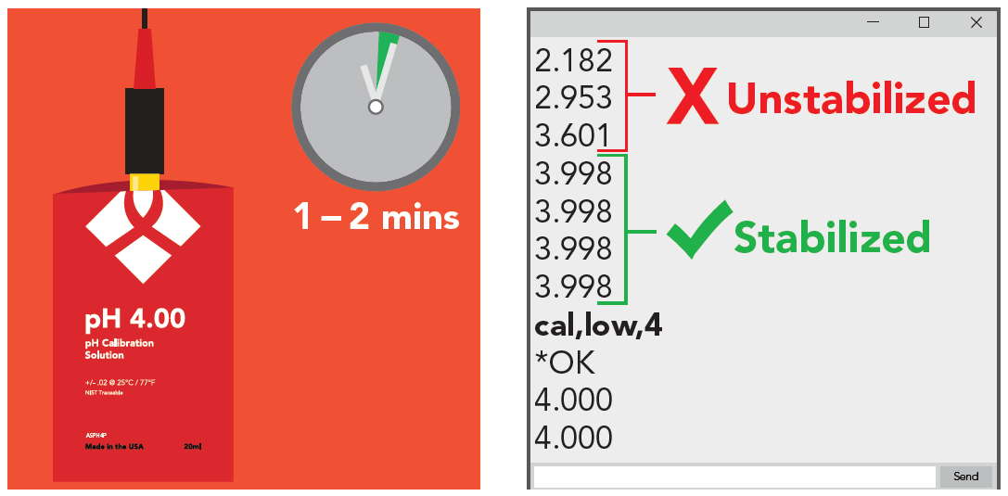
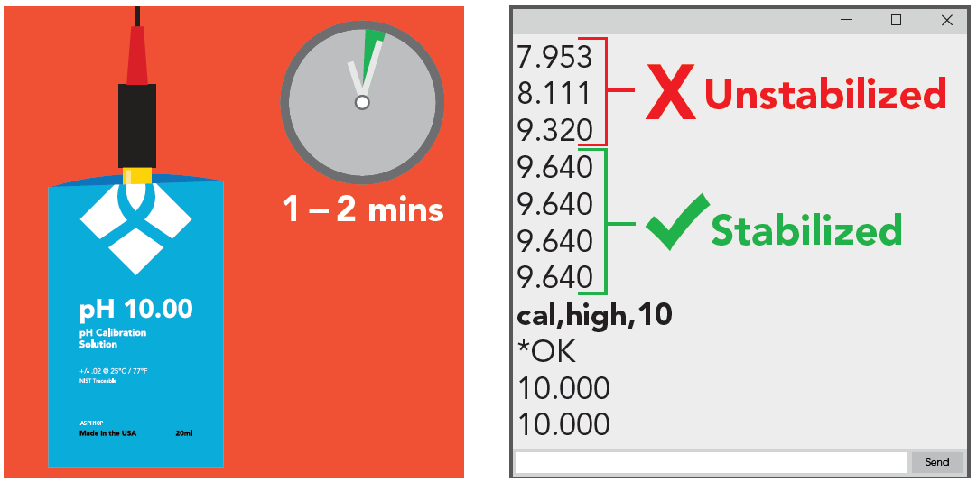
Calibrating Sensor (pH sensor)
Fig. 19: Atlas Scientific pH Kit

Slide 17
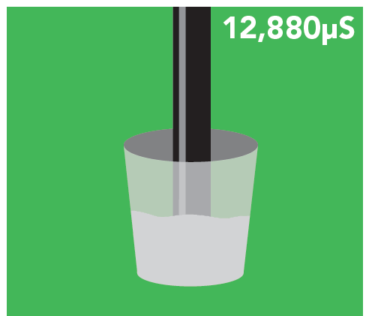
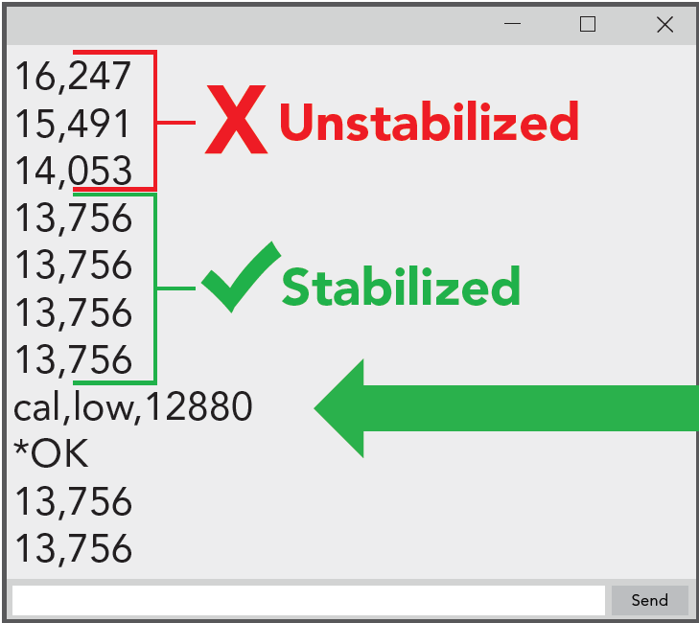
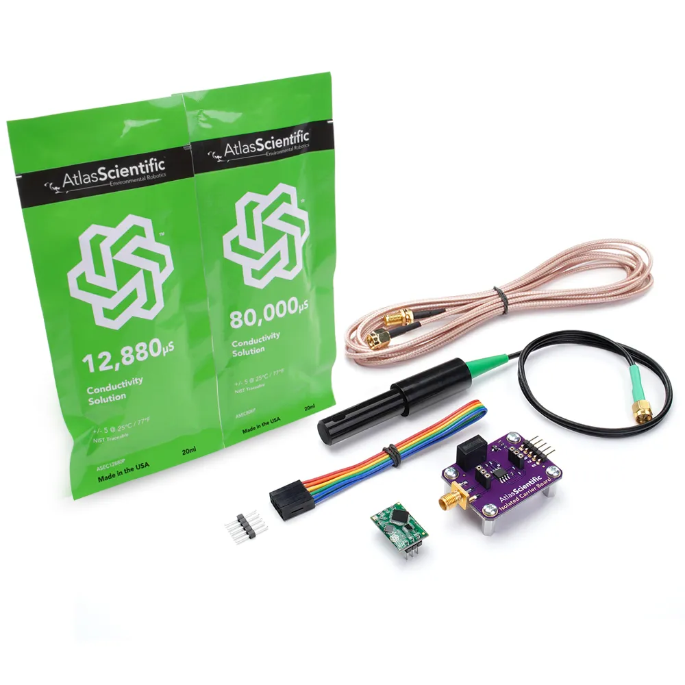
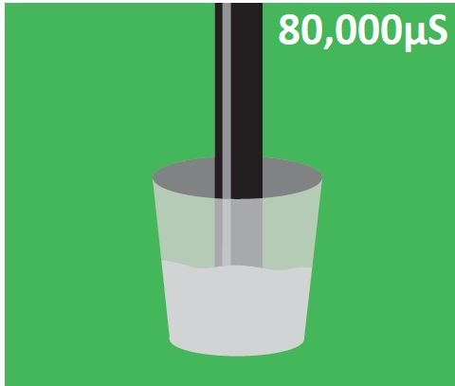
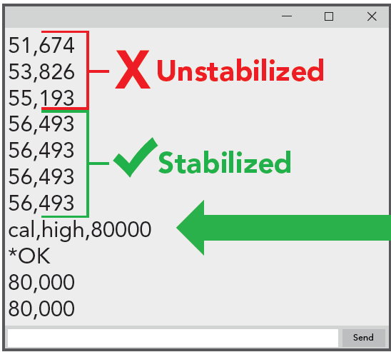
Calibrating Sensor (EC sensor)
Fig. 20: Atlas Scientific Conductivity K 1.0 Kit

Slide 18
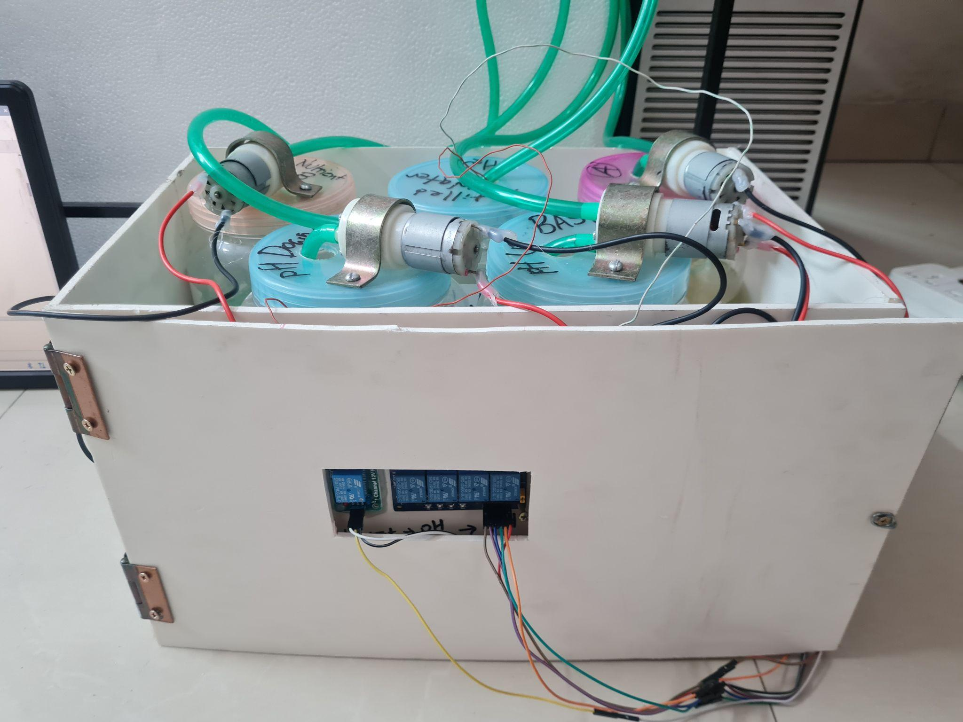
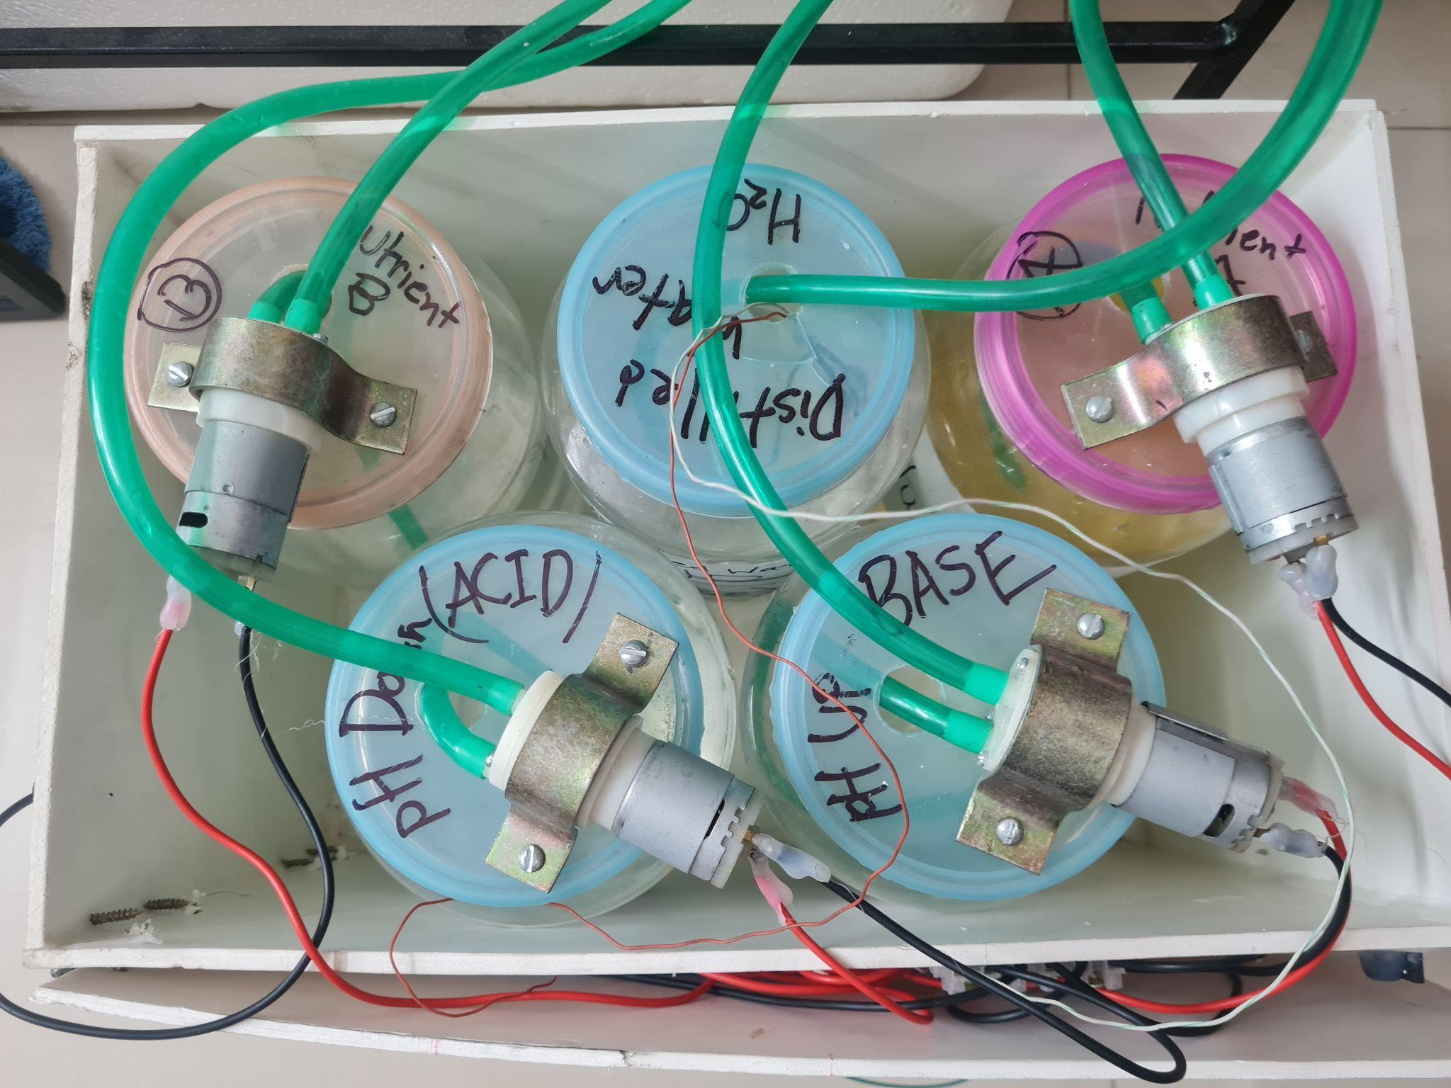
Regulating pH and Nutrient Level
Vaccum Pump
Fig. 28: Front View of Acid/Base and Nutrient Dosing System
Fig. 29: Top View of Acid/Base and Nutrient Dosing System

Slide 19
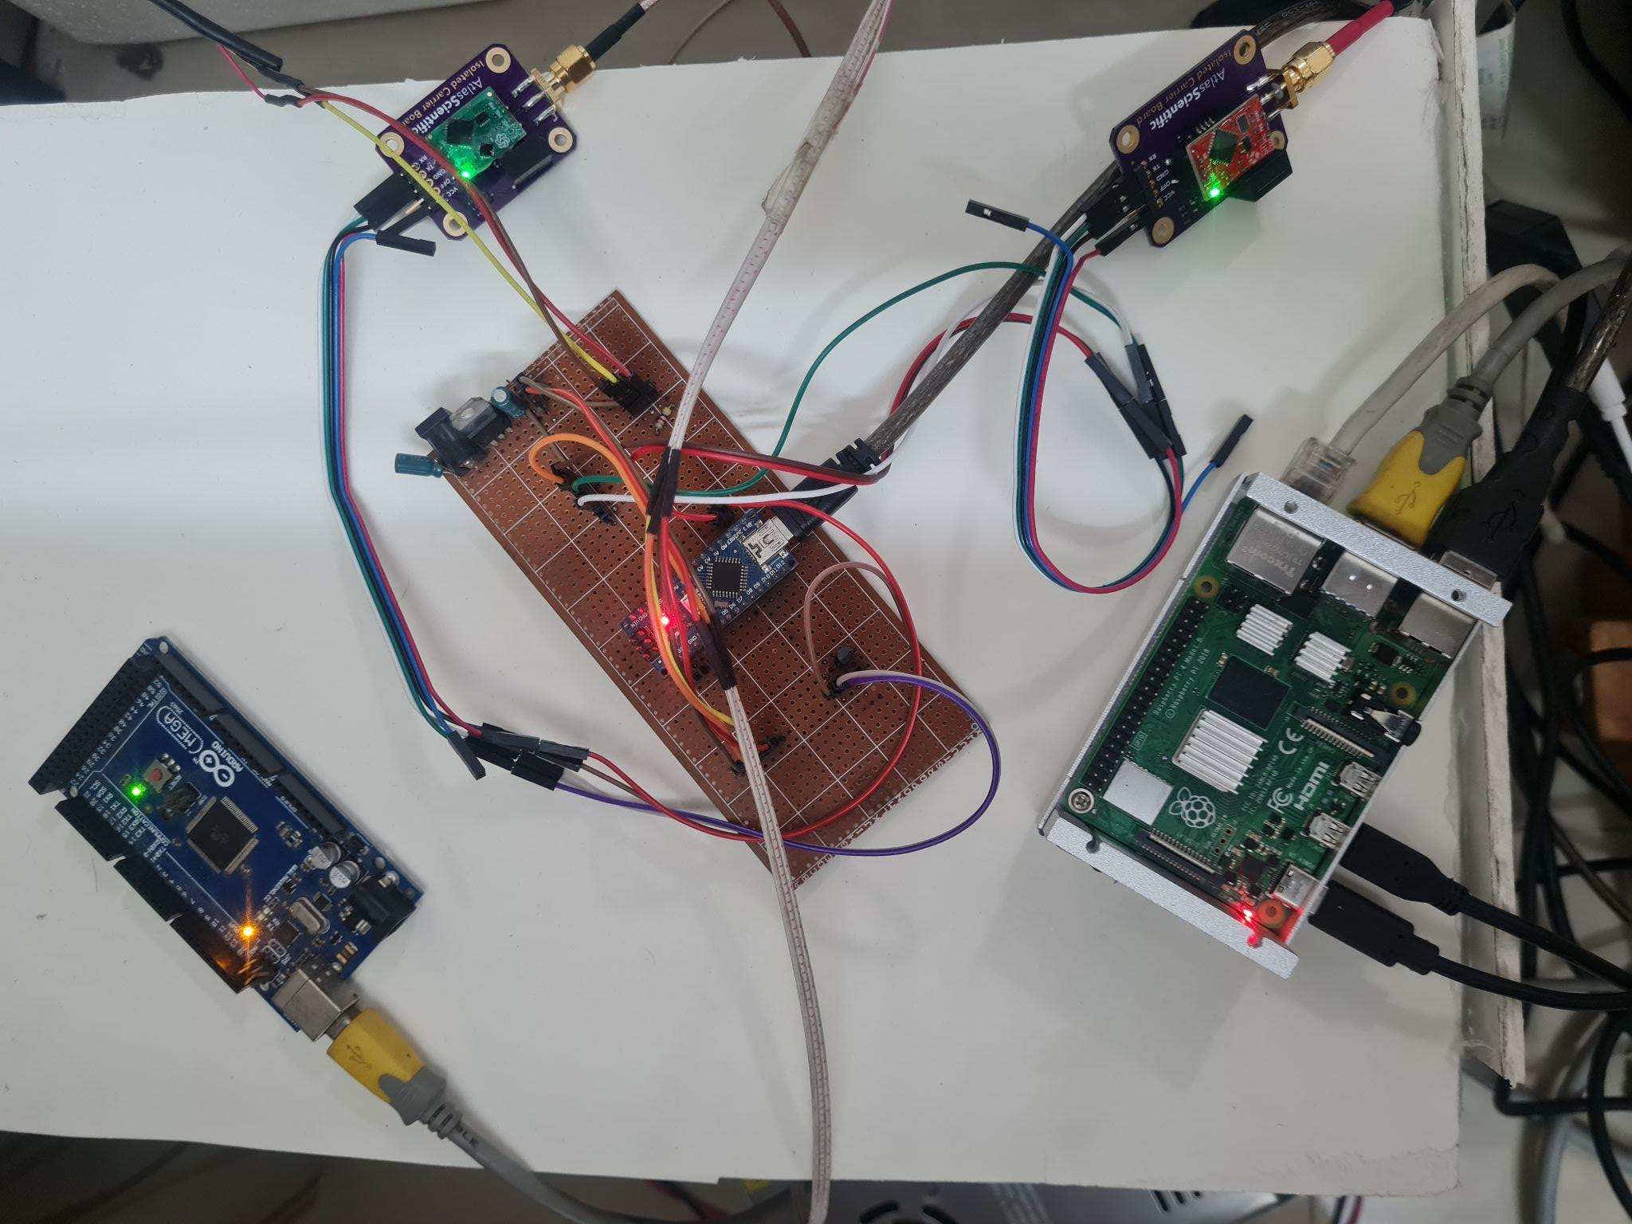
Control Unit
Sensor
Board
Raspberry Pi 4
Arduino Mega for Actuation
Fig. 32: Control Unit showing the connections between the Raspberry Pi, the Arduino Mega and Arduino Nano

Slide 20
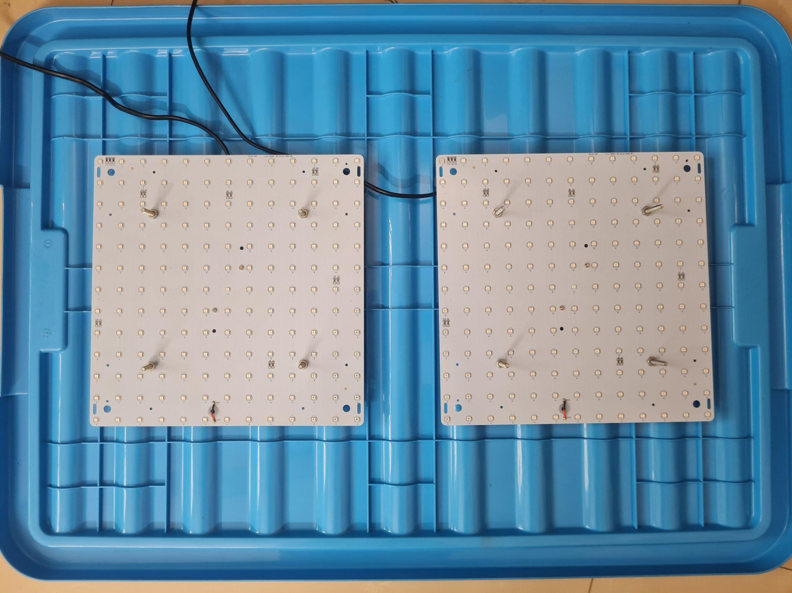

Growth Module
Grow Lights
Fig. 33.1: Top view of Grow Lights bolted on the underside
of the lid (turned off)
Fig. 33.2: Top view of Grow Lights bolted on the underside
of the lid (turned on)

Slide 21
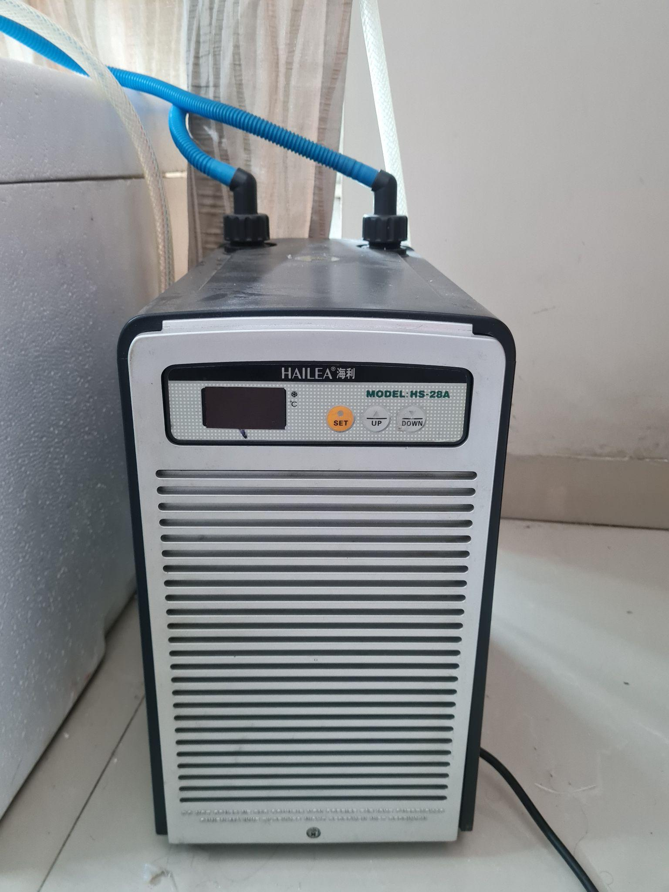

Regulating Water Temperature
Concede Box
Hailea HS-28A
Aquarium Chiller
Fig. 35: Hailea HS-28A Aquarium Chiller
Fig. 37: Concede Box Containing the Nutrient Container Module

Slide 22


Regulating Air Temperature
CPU Cooler
Connector
Board
Peltier Module
Fig. 38.1: Isometric view of Air Cooling System
Fig. 38.2: Top view of Air Cooling System

Slide 23


Regulating CO2
Solenoid Valve
Hailea HS-28A
Aquarium Chiller
Pneumatic Connector
Silicone Tube
Fig. 38.2: Pneumatic Connector Fitting
Fig. 38.2: CO2 Cylinder

Slide 24
Regulating CO2

Slide 25

Automated AC Power Supply
Grow Lights
Water Chiller
Water Pump for Chiller
Fig. 39: Automated Multiplug using a 4-channel 12V relay

Slide 26

DC Power Supply
Water Pumps
Peltier Module
Fig 40: Switched-Mode Power Supply (SMPS) 12V - 30A Power Supply

Slide 27


Monitoring Sensor Reading
Fig. 41: Web-based dashboard showing the visualizations from ThingSpeak from sensor data logged by the Raspberry Pi
Fig. 42: Web-based dashboard showing the widgets from ThingSpeak from sensor data logged by the Raspberry Pi

Slide 28

Collecting Data
Fig. 43: Sensor data logged by the Raspberry Pi being stored in Google Sheets

Slide 29

Decision Making Flowchart
Fig. 44: Flowchart of sensor system.

Slide 39
Experimental Demonstration of the System

Slide 40
Results

Slide 41
Data from the System after an interval
Fig. 49: Visualizations from the sensor data collected by the system after a time interval

Slide 42
Data from the System after an interval
Fig. 50: Update Values from the sensor data collected by the Raspberry Pi after a time interval

Slide 43
Google Sheet Spreadsheet updates
Fig. 51: The Google Sheet spreadsheet showing the sensor data logged by the Raspberry Pi since system startup

Slide 44

Result
Fig. 52: Serial Monitor readings from testing the sensors.
Table 1: Serial Monitor readings from testing the sensors [1]
[1] C. S. Dr. Melissa Brechner, Dr. A.J. Both, Hydroponic Lettuce Handbook. New York, USA: Cornell University Controlled Environment Agriculture Program, 2013.

Slide 45
Expected Work To Be Done

Slide 46
Expected Work To Be Done
Adding CO2 cylinders to Growth Module (GM) as a CO2 source
Growing a batch of lettuce to test the system
Implementing an Xgboost-based decision-making system
Developing and controlling multiple Growth Modules (GMs) simultaneously

Slide 47

Project Timeline
Fig. 53: Timeline for the different stages of the project

Slide 48
Conclusion

Slide 49
Conclusion
This system will enable us to grow crops which would otherwise not grow in Bangladesh.
It will allow us to grow plants much faster than conventional soil-based farming.
Produce from this system will be free of pesticides and thus much healthier.
Our system will control more parameters than previous works
Thus far, we have implemented automation to monitor and control the pH, EC, Air Temperature, Water Temperature, Humidity and Light Cycle.
We implemented IoT to our system and developed a web-based dashboard to monitor the physical parameters remotely.
We plan on developing a decision making system based on Xgboost while running multiple Growth Modules simultaneously.

Slide 50
References
[1] C. S. Dr. Melissa Brechner, Dr. A.J. Both, Hydroponic Lettuce Handbook. New York, USA: Cornell University Controlled Environment Agriculture Program, 2013.

Slide 51
Thank You

